Slide 1
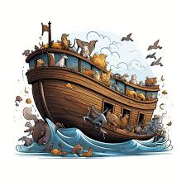
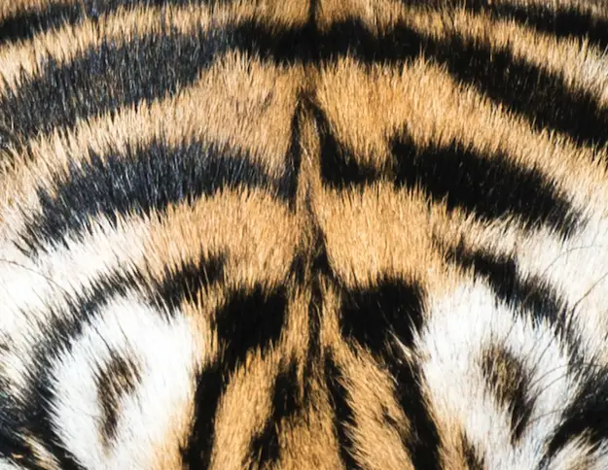
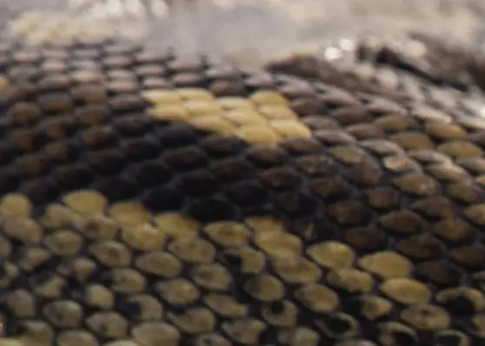
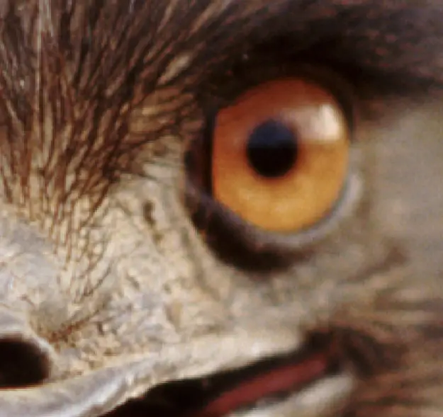
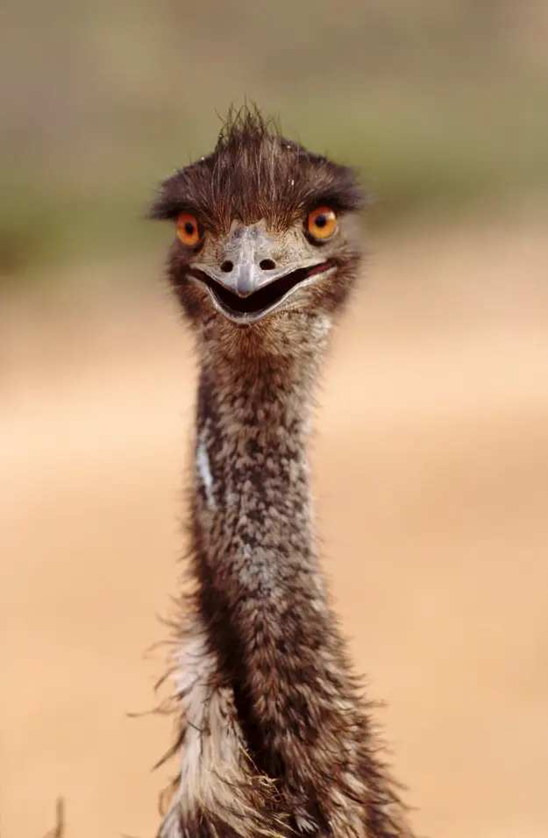
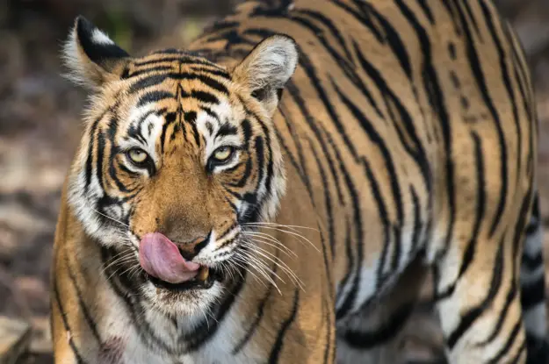
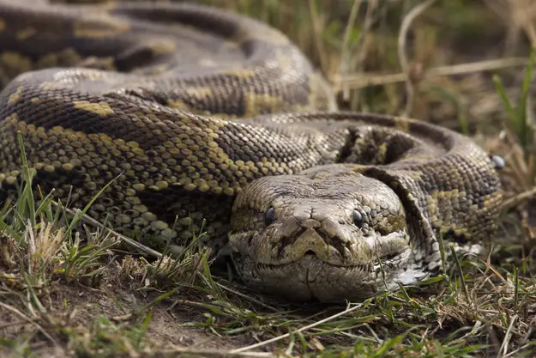
Noah –World in a mess Genesis 6-7
Guess the animal
TIGER
SNAKE
EMU

Slide 2
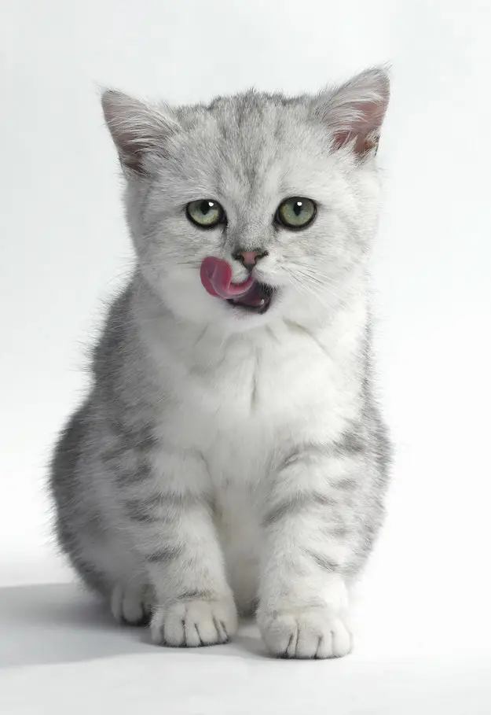
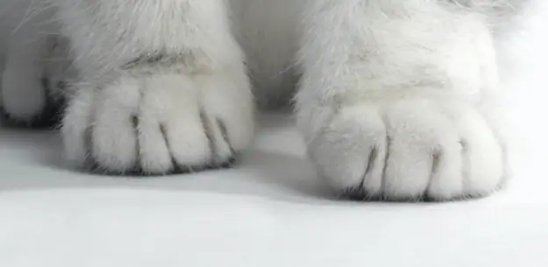
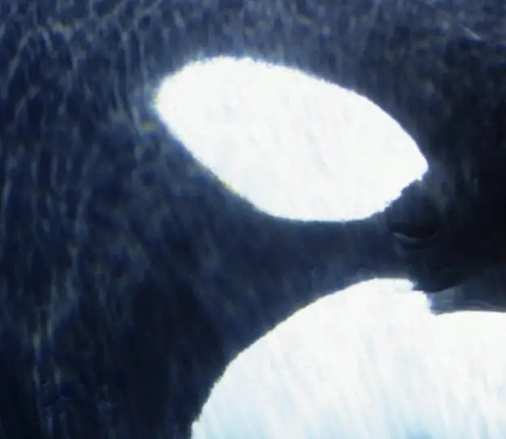
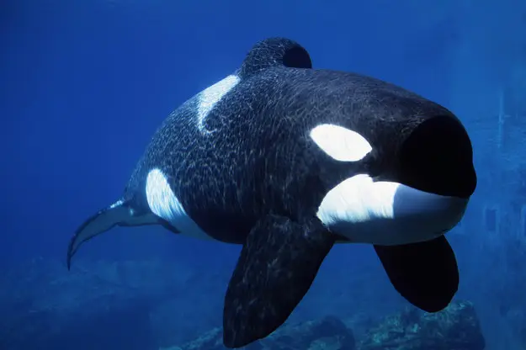
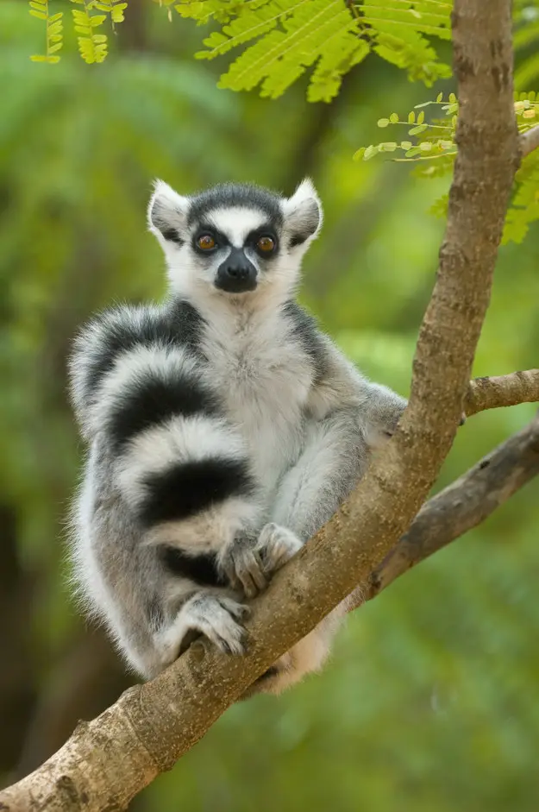
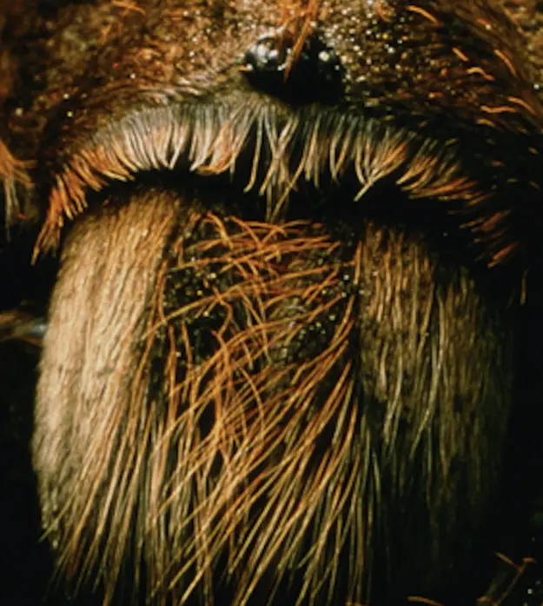
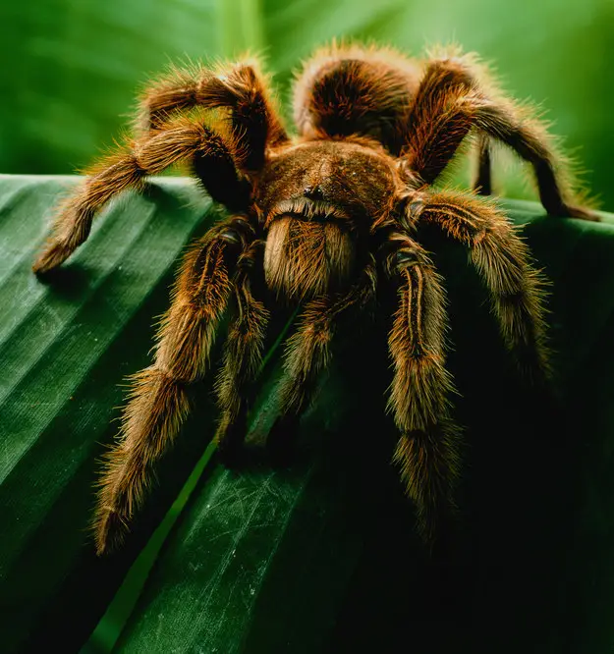
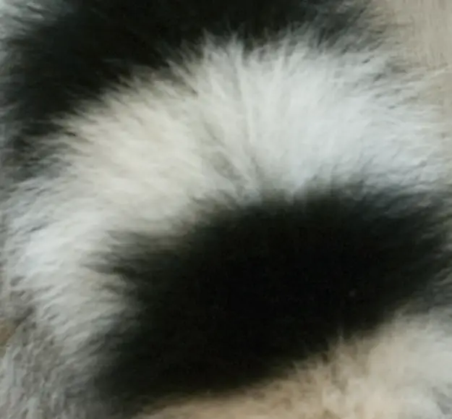
CAT
ORCA
LEMUR
TARANTULA

Slide 3
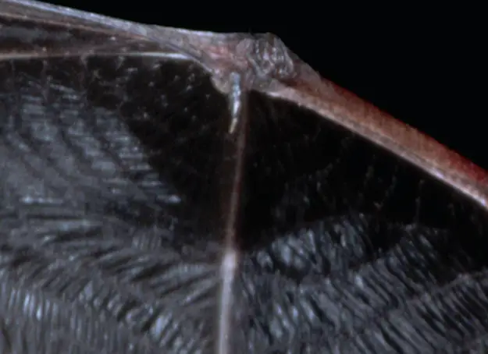
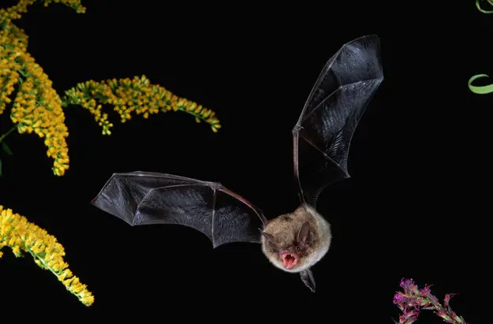
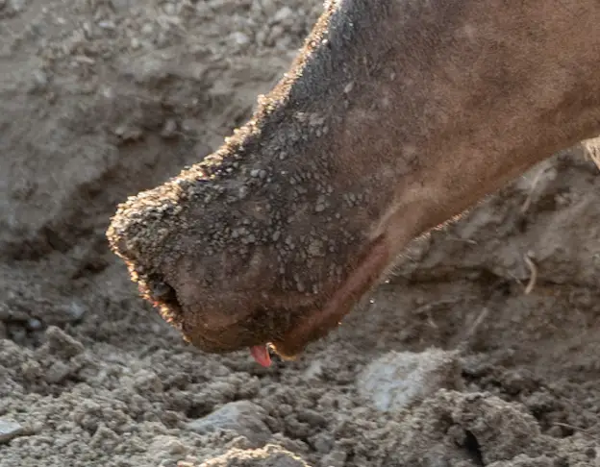
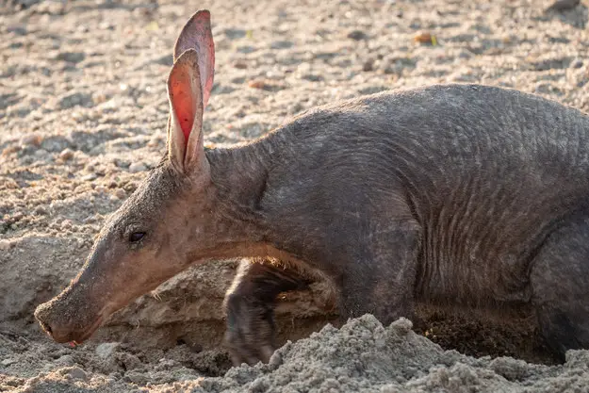
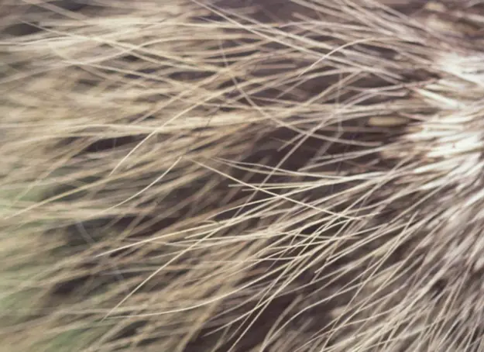
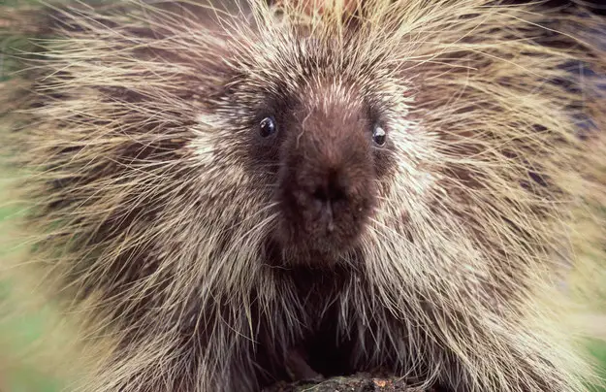
BAT
AARDVARK
PORCUPINE

Slide 4
Read Genesis 6:1-8
In groups discuss the questions
and then feedback
1. Why was God ‘grieved that He had made humans?
2. The text doesn’t give us clues about what made
man wicked except for Human hearts filled with evil all the time.
What do you think that means? What might life have been like?
3. Is the world better or worse today?
4. How might we grieve God?
5. In v 3, why can’t God’s Spirit put up with mankind?

Slide 5
Read Genesis 6:9-22
In groups discuss the questions
and then feedback
6. Why was Noah chosen to build the Ark?
7. Why are God’s instructions so specific?
8. If you were asked to build a boat in the middle of the
land, miles from water, what would you say/think?
Do you think Noah was any different?
9. How did Noah respond? Why did he respond this way? (18)

Slide 6
1. Make an Ark
2. Use Cypress wood
3. Make rooms in it.
4. Cover it in pitch inside and out
5. 450ft long (137m)
6. 75ft wide (23m)
7. 45ft high (14m).
8 Make a roof
9. Overhang 18 inches from top (45cm)
10.Door in the side
11.Lower and middle decks.

Slide 7
Reflection
What does it mean to walk with the Lord?
How will your life be different from other friends who don’t know Jesus?
How hard is it to live for Jesus at school /home?

