Slide 1
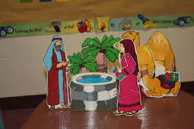
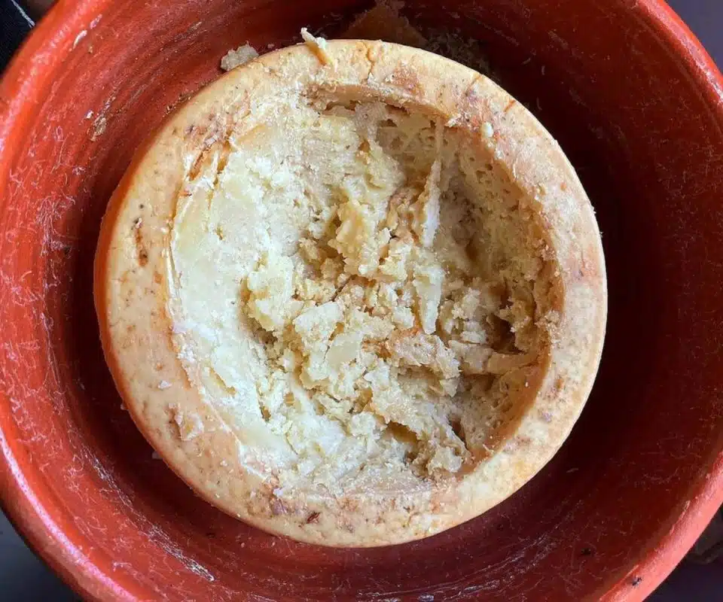
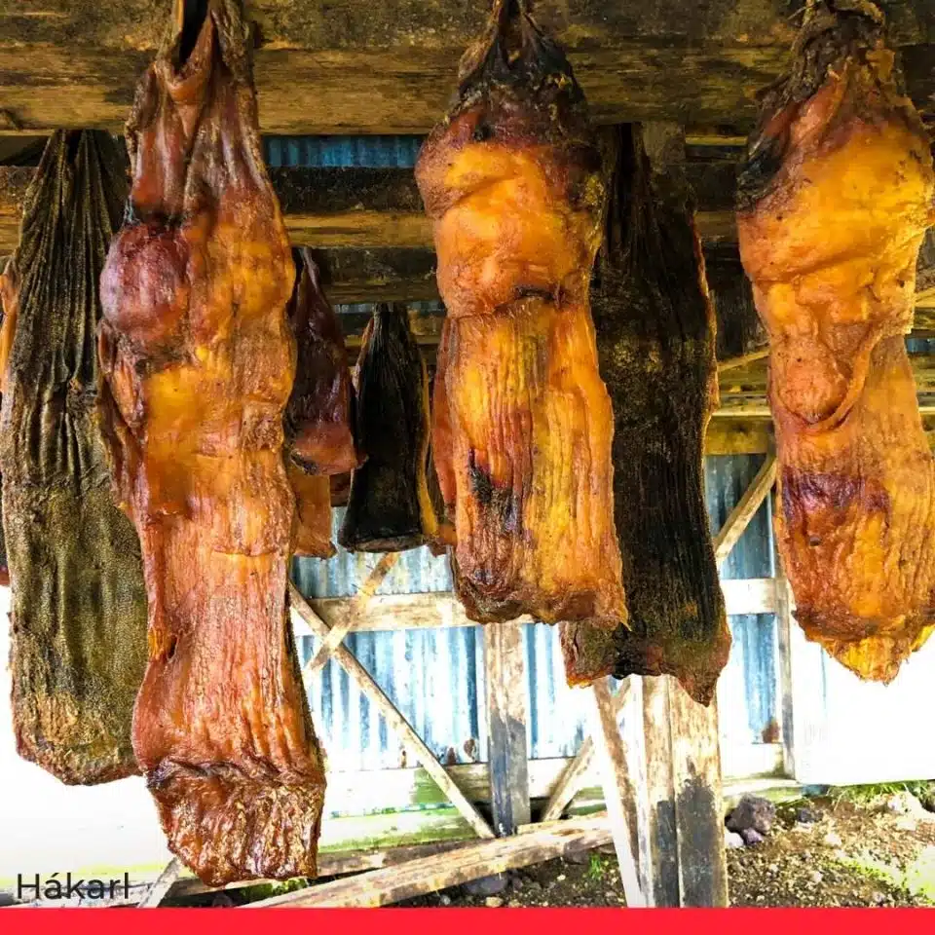
Isaac:- blinded by food
Would you eat these?
Casu Marzu (Maggot Cheese) – Italy
Hákarl (Decomposed Shark Carcass) – Iceland

Slide 2
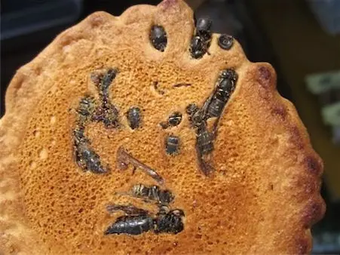
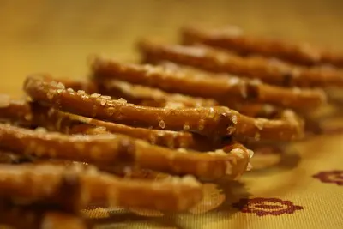
Jibachi Senbei (Wasp Rice Snack) – Japan
Worm Pretzels – USA

Slide 3
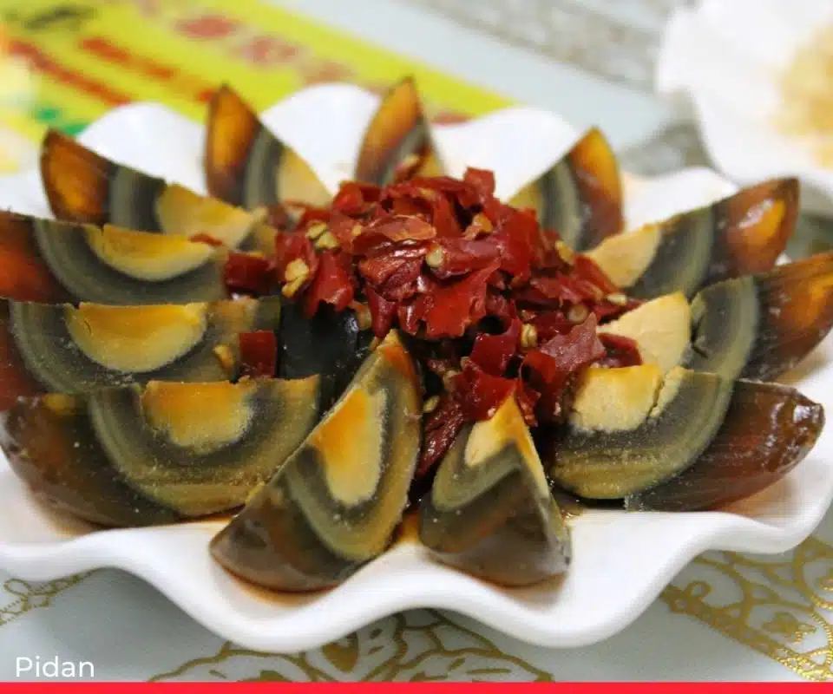
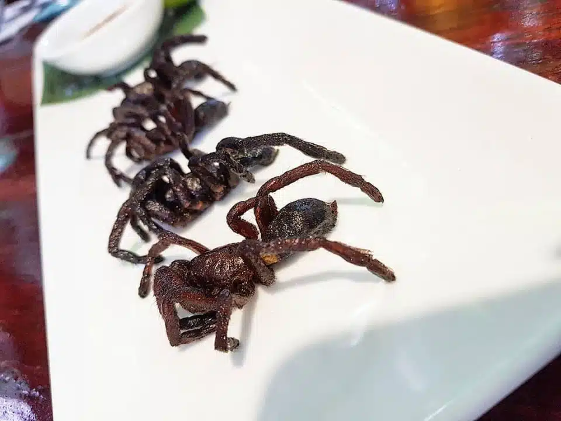
Pidan (Rotten Eggs) – China
Fried Tarantula – Cambodia

Slide 4
Genesis 27:1-35
1. Not only was Isaac physically blind, but he appears
to be “blinded” by a passion. What passion?
2. Who is the worst person in this story? (Isaac for
falling for the trick? (Rebekah for eavesdropping and
planning the trick? Jacob for agreeing to deceive his
father? Esau for being tricked by his brother twice!)
3. What advice would you give to Isaac to prevent what
happened?

Slide 5
Using the flip chart…
list the things that
· Could “blind” you from doing the right thing
· Could “blind” you from seeing the truth about
Jesus
· Could “blind” you from being loyal and
respectful to your family

Slide 6
Discussion in groups or together
1. Are there common things?
2. Which do you think are the most
dangerous or most likely to “blind”
you? Why?
3. What might be your “blind” spots?

Slide 7
STRENGTHS
Hard worker
Compassionate
Caring
Kind
Helpful
Thoughtful of others
Trustworthy
Reliable
Loyal
Generous
Gracious
Joyful
Self controlled
Blind Spots?
Obsessed by…
Sport
Music
Fashion/appearance
Make up
Friends
Boyfriend/ girlfriend
School work
Hobby
Spend too long on…
Social media
Gaming
Texting mates
Think too much about
Food
Money
Possessions I want
What others think of me
What I want out of life

