Slide 1
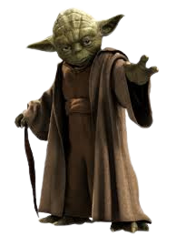


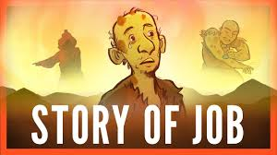
A message from the dark side of scripture... you have!
Job:
Why does God allow suffering?
Things your Sunday School teacher didn’t teach you

Slide 2
A message from the dark side of scripture... you have!
Lets get messy!
Things your Sunday School teacher didn’t teach you
Who can find the coins hidden in the goo?

Slide 3

A message from the dark side of scripture... you have!
Activity 1`
Things your Sunday School teacher didn’t teach you

Slide 4
A message from the dark side of scripture... you have!
Activity 1`
Things your Sunday School teacher didn’t teach you
What questions do you have about the story of Job?
What was Job like at the start? Job 1:1-3
3. What did he lose? Why did he lose it?
4. How does Job respond to this pain and suffering? Job 1: 20-22
Does this kind of pain and suffering happen today?
How might you respond?

Slide 5
A message from the dark side of scripture... you have!
Activity 2`
READ: Job 38:1-8 This is a short section of a much longer passage about God’s response.
1. What do you think God is trying to teach Job by asking these questions?
2. How do you think Job responded? (See 40:3-5 for the answer. Also Job 42:1-5)
3. How do you think you would have responded?
4. What picture does God paint of Himself in these chapters? (Scan more of the dialogue if you need to.)
5. What happens in the end? What does this reveal about God?
Things your Sunday School teacher didn’t teach you

Slide 6
A message from the dark side of scripture... you have!
Activity 3`
Things your Sunday School teacher didn’t teach you
Read James 1:2-41.
Does it make sense that we should be joyful when suffering?
Why/why not?
What does James say trials will do?
Did we find this true of Job?
Facing trials can be hard. Usually it’s because we find ourselves asking “why?” Like Job, we wonder why things have happened to us.

Slide 7
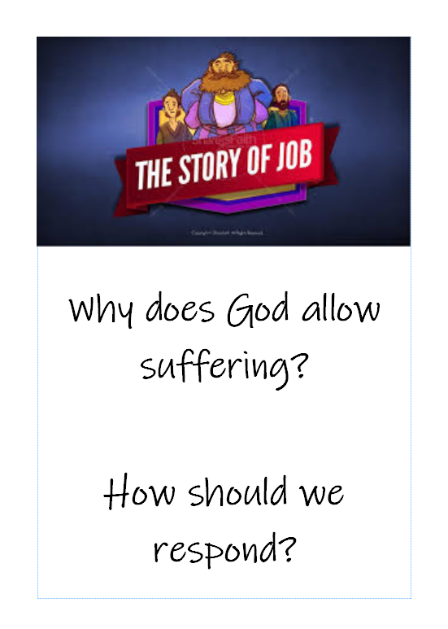
A message from the dark side of scripture... you have!
Takeaway
Things your Sunday School teacher didn’t teach you
Please takeaway a booklet.
It will help you understand some of the struggles you may go through

