Slide 1
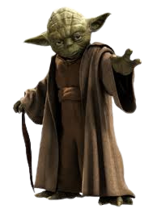


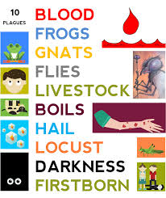
A message from the dark side of scripture... you have!
The Plagues of Egypt:
God defeats the idols of Egypt!
Things your Sunday School teacher didn’t teach you

Slide 2
A message from the dark side of scripture... you have!
Let’s play… Which is better?
Things your Sunday School teacher didn’t teach you
The Eiffel Tower OR Statue of Liberty
The Pyramids of Egypt OR The Great Wall of China
Winston Churchill OR William The Conqueror
The car engine OR Microchip
Escalators OR lifts
Internet OR space travel
Messi OR Ronaldo
Football or Rugby
Why did you choose, the one you did?
Has anyone changed their mind now someone has given a reason?

Slide 3
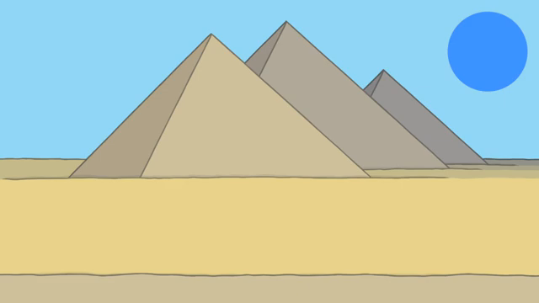
A message from the dark side of scripture... you have!
Activity 1
Things your Sunday School teacher didn’t teach you

Slide 4
A message from the dark side of scripture... you have!
Things your Sunday School teacher didn’t teach you
Why did God send the plagues?

Slide 5
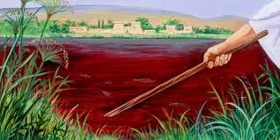
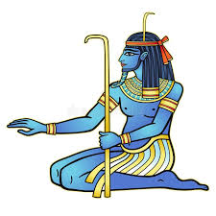
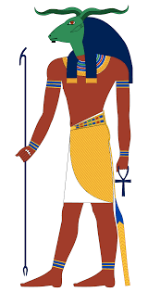
A message from the dark side of scripture... you have!
The plagues as a battle to show Yahweh’s power
Things your Sunday School teacher didn’t teach you
Hapi: the god of the Nile
Khnum: Guardian of the Nile source.
God of fertility and life
By turning the Nile to blood, God demonstrates His power over the source of life, water. Hapi and Khnum are powerless to stop it.

Slide 6
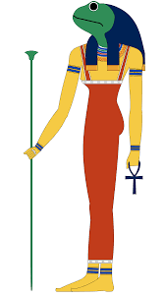
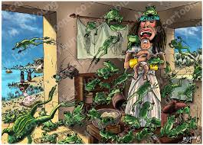
A message from the dark side of scripture... you have!
Things your Sunday School teacher didn’t teach you
Heket; god of fertility and childbirth. Depicted with a frog head. She was a symbol of life.
A plague of frogs brought disease and death and not life. The opposite of Heket’s power. She was unable to stop it!

Slide 7
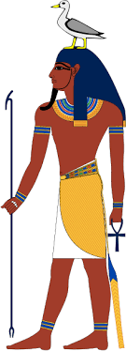
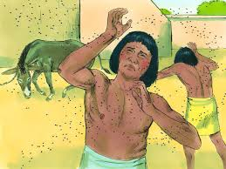
A message from the dark side of scripture... you have!
Geb: God of the earth and soil. He protects the ground and ensures it is fruitful.
Things your Sunday School teacher didn’t teach you
By raising a swarm of gnats from the ground, Yahweh is showing that Geb is powerless to control anything

Slide 8
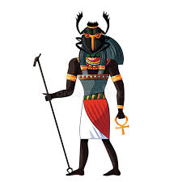
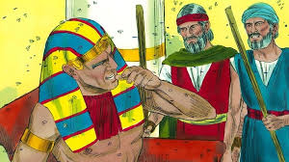
A message from the dark side of scripture... you have!
God now takes it up a notch by separating out the plague victims from His people the Hebrews! The Hebrews were not affected by any of the following plagues!
Things your Sunday School teacher didn’t teach you
Khepri: a God of creation and rebirth. Often depicted with a head of a fly or scarab(Flying beetle)
The plague of flies brought disease, destruction and death. Khepri was powerless to stop it. The Hebrew slaves did not experience this. God protected them!

Slide 9
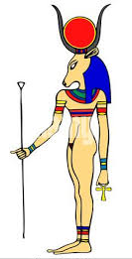
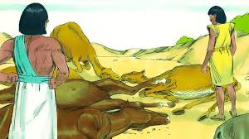
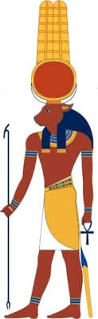
A message from the dark side of scripture... you have!
Hathor: God of love and protection. In Egypt, cows were sacred. Hathor was depicted with a cow’s head.
Things your Sunday School teacher didn’t teach you
Apis: The bull god. A god of strength and fertility. Protector of the sacred animals
When all the livestock of the Egyptians died, but those of the Hebrews lived, God was demonstrating His superior power of these two gods. They were powerless to protect.

Slide 10
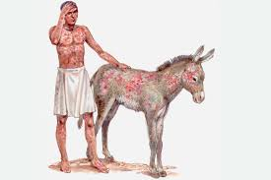
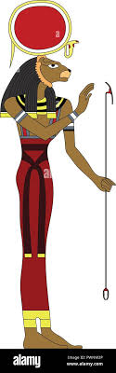
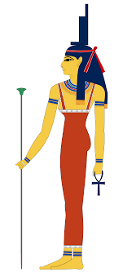
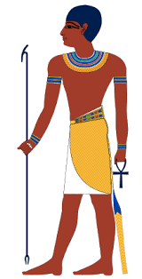
A message from the dark side of scripture... you have!
Sekhmet: god of war and healing. Protector against illness
Things your Sunday School teacher didn’t teach you
Isis: god of medicine and peace
By devastating the land with unpleasant boils and sores on the Egyptians, and not the Hebrews, God demonstrates the failure of these three gods to act in Egypt’s defence.
Imhotep: the god of healing

Slide 11
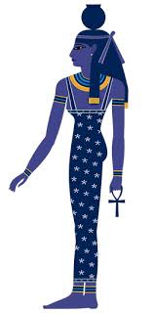
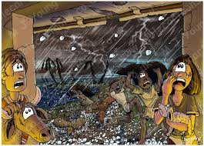
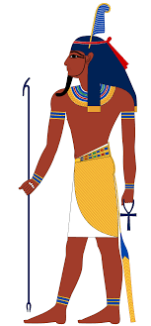
A message from the dark side of scripture... you have!
Nut: the sky god
Things your Sunday School teacher didn’t teach you
Shu: the god of the air/ wind
These two gods protect the earth from disaster.
The hail storm caused massive destruction and death across Egypt. Destroying crops, property and animals. The failure of these two gods to stop this disaster would be obvious to all

Slide 12
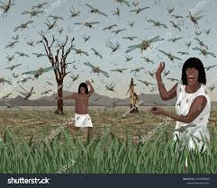
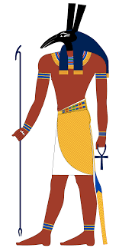
A message from the dark side of scripture... you have!
Things your Sunday School teacher didn’t teach you
Seth: god of the desert, storms and chaos
The locusts would have destroyed what was left after the hail, leaving the Egyptians starving and helpless. Seth was supposed to stop disasters and chaos from happening.

Slide 13
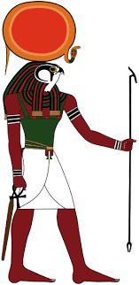
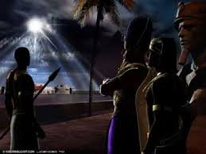
A message from the dark side of scripture... you have!
RA: the sun God.
The most powerful Egyptian God. The god of light and life.
Things your Sunday School teacher didn’t teach you
The selective and total darkness that God brought down on Egypt
Was a direct attack on RA, the sun god. By giving light to the Hebrews
and not the Egyptians he was demonstrating his total power!

Slide 14
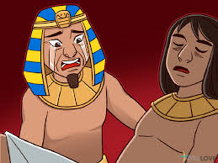
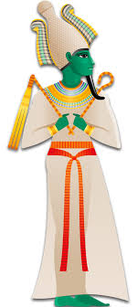
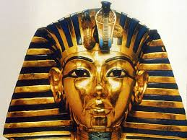
A message from the dark side of scripture... you have!
Osiris: the god of the afterlife and protector of souls.
In Egypt the Pharaoh was
also seen as a god.
Things your Sunday School teacher didn’t teach you
This final attack revealed God’s true power over life and death. Pharaoh and Osiris were unable to protect the nation from this devastation.

Slide 15
A message from the dark side of scripture... you have!
Activity 2
God uses the plagues as a warning about our choices
Read Exodus 8:1 and 12:28-32
1. What message does Moses give to Pharaoh in 8:1?
2. What happened as a result of Pharaoh’s refusal?
Why did he keep refusing?
3. Are the plagues fair? How does God judge and show mercy
during this time?
Things your Sunday School teacher didn’t teach you

Slide 16
A message from the dark side of scripture... you have!
Hardness of heart
Read Exodus 9:34-35
1. Why was Pharaoh’s heart hard?
2. What in our life can cause hardness of heart
towards God?
3. Is it possible to soften your heart?
Activity 3.
Things your Sunday School teacher didn’t teach you

Slide 17
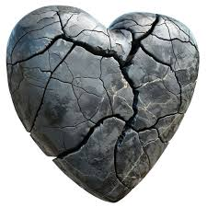

A message from the dark side of scripture... you have!
Things your Sunday School teacher didn’t teach you
And I will give you a new heart, and a new spirit I will put within you.
And I will remove the heart of stone from your flesh and give you a heart of flesh.
And I will put my Spirit within you, and cause you to walk in my statutes and be careful to obey my rules. Ezekiel 36:26-27

