Slide 1
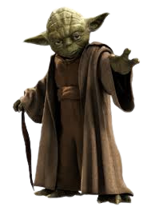


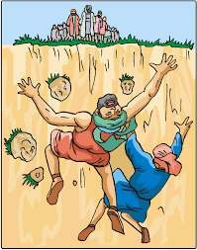
A message from the dark side of scripture... you have!
Korah and the Rebellion.
Responding to God’s calling
Things your Sunday School teacher didn’t teach you

Slide 2

A message from the dark side of scripture... you have!
Things your Sunday School teacher didn’t teach you

Slide 3
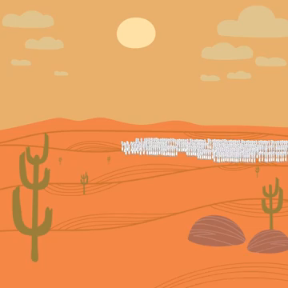
A message from the dark side of scripture... you have!
Read Numbers 16
Activity 1
Things your Sunday School teacher didn’t teach you

Slide 4
A message from the dark side of scripture... you have!
Activity 1
1. Why was Korah dissatisfied with his role in life? What was his role? Was it important?
2. Why did he think Moses had “gone too far?”
3. What had Korah forgotten about the past?
4. Do you think the other rebels would have rebelled if it were not for Korah?
5. Can you think of a time you have been dissatisfied with something? How did you deal with it?
Things your Sunday School teacher didn’t teach you

Slide 5
A message from the dark side of scripture... you have!
Activity 2
Read Numbers 16:19-21 then Numbers 16:28-30
1. Why do you think God was so angry with Korah? After all he wanted to be a priest. Isn’t that a good thing?
2. Who was Korah disrespecting, Moses as leader, or God?
3. What does God do to show everyone that Korah had disrespected Him?
4. Was this harsh?
Things your Sunday School teacher didn’t teach you

Slide 6
A message from the dark side of scripture... you have!
Activity 3
1. What are the things that make us rebel against God and doubt His judgment?
2. How do we know God has our best interests at heart? Lookup the following:
Deuteronomy 31:8 Isaiah 46:4 Romans 5:8
Romans 8:28 I peter 5:6-7
3. What do we do if we think we have rebelled and sinned against God?
I John 1:9 James 5:16
Things your Sunday School teacher didn’t teach you

Slide 7

A message from the dark side of scripture... you have!
Things your Sunday School teacher didn’t teach you
Spend time reflecting on the need to trust God, as you colour in the sheet

Slide 8
A message from the dark side of scripture... you have!
Things your Sunday School teacher didn’t teach you

Slide 9
A message from the dark side of scripture... you have!
Things your Sunday School teacher didn’t teach you

