Slide 1
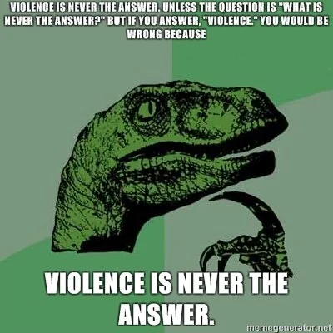
A message from the dark side of scripture... you have!
Ehud and Jael:
Is violence ever the answer?
Things your Sunday School teacher didn’t teach you

Slide 2
A message from the dark side of scripture... you have!
Judges 3:12-30 - EHUD
Activity 1
Things your Sunday School teacher didn’t teach you

Slide 3
A message from the dark side of scripture... you have!
Judges 4
Activity 1
Things your Sunday School teacher didn’t teach you
https://www.youtube.com/watch?v=2_4hjWWoxPA

Slide 4
A message from the dark side of scripture... you have!
Activity 1
Things your Sunday School teacher didn’t teach you
1. What do you notice about both stories?
2. What do you think of the way the bad guys were dealt with?
3. Why do you think God allowed such violence to take place?

Slide 5
A message from the dark side of scripture... you have!
The Amalekite problem
Activity 2
Read Genesis 12:2-3.
1.What does God promise?
2. What might a blessing or a curse look like?
The Amalekites were a race of people descended from Esau. They were a constant thorn in the side of Moses as he led the people out of Egypt. They would attack, ambush and kill the stragglers, the old and weak from God’s people.
Read: Exodus 17:8-15. THEN Read 1 Samuel 15:1-3,
1. What does God promise in Exodus?
2. What does He command in 1 Samuel?
Things your Sunday School teacher didn’t teach you

Slide 6
A message from the dark side of scripture... you have!
Activity 3
Jesus and violence
Things your Sunday School teacher didn’t teach you
1. What does Jesus say about violence?
Look up Matthew 5:43-48 Matthew 26:52
2. Why was Jesus’ death so violent?

Slide 7
A message from the dark side of scripture... you have!
TAKEAWAY
In 1 Samuel 15, Saul does not obey God completely and spares the lives of the King of Amalek and many animals. This disobedience cuts him off from God’s blessing.
THINK CAREFULLY
What are the things in our lives that God wants us to destroy (sins) but we are still clinging to? Are they worth missing out on God’s blessing?
Things your Sunday School teacher didn’t teach you

Slide 8
A message from the dark side of scripture... you have!
Things your Sunday School teacher didn’t teach you

