Slide 1
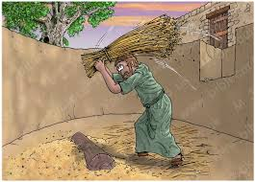
A message from the dark side of scripture... you have!
The call of Gideon:
Really God… you want me?
Things your Sunday School teacher didn’t teach you

Slide 2
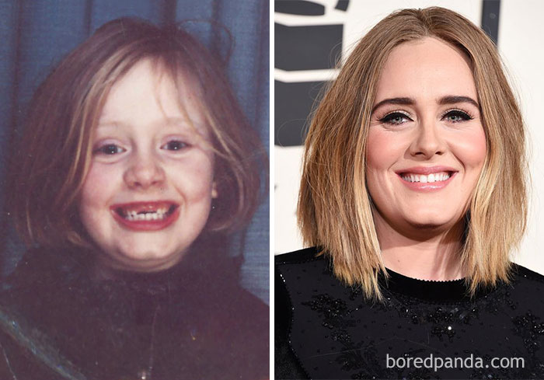
A message from the dark side of scripture... you have!
Who is this future pop star?
Things your Sunday School teacher didn’t teach you

Slide 3
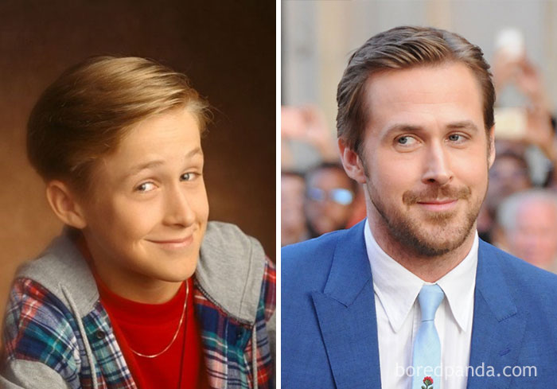
A message from the dark side of scripture... you have!
Who is this future actor?
Things your Sunday School teacher didn’t teach you

Slide 4
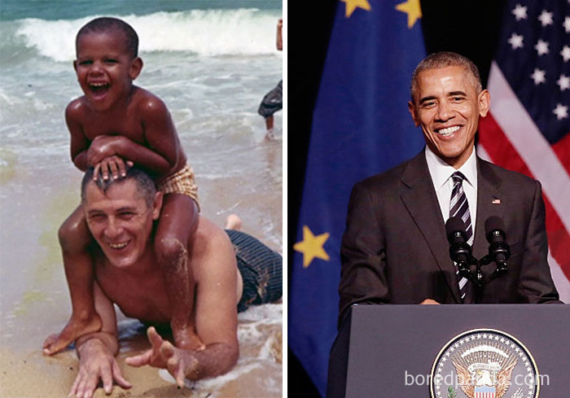
A message from the dark side of scripture... you have!
Who is this future world leader?
Things your Sunday School teacher didn’t teach you

Slide 5
A message from the dark side of scripture... you have!
Who is this famous actor?
Things your Sunday School teacher didn’t teach you

Slide 6
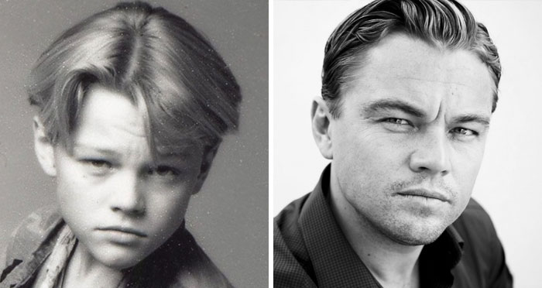
A message from the dark side of scripture... you have!
Who is this famous actor?
Things your Sunday School teacher didn’t teach you

Slide 7
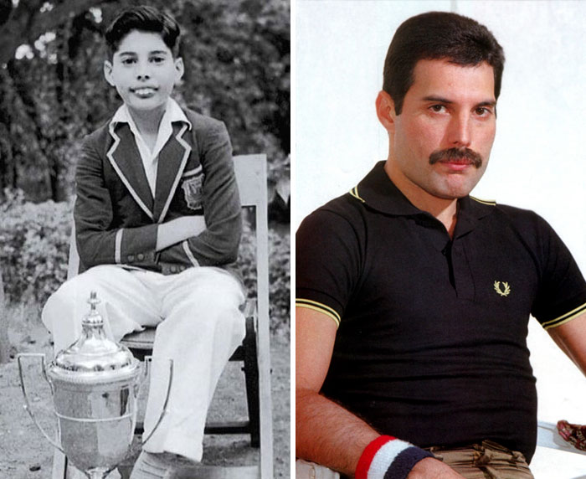
A message from the dark side of scripture... you have!
Who is this famous singer?
Things your Sunday School teacher didn’t teach you

Slide 8
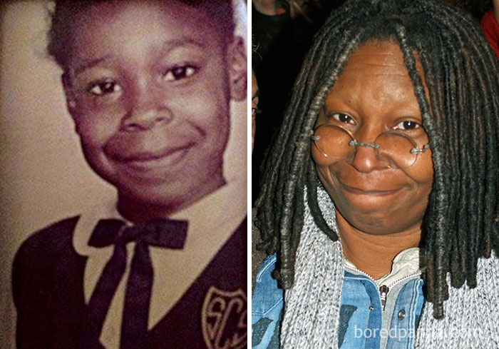
A message from the dark side of scripture... you have!
Who is this famous actor?
Things your Sunday School teacher didn’t teach you

Slide 9
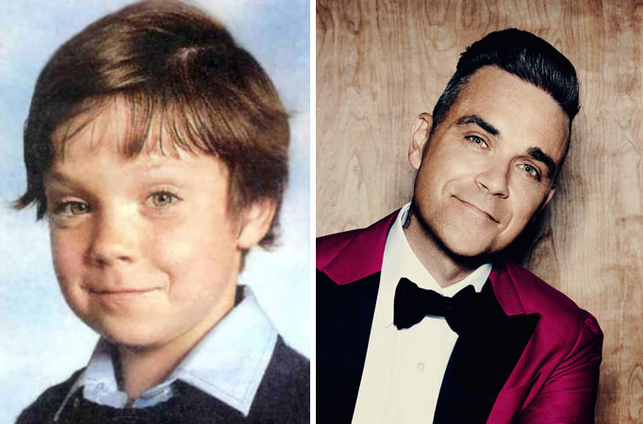
A message from the dark side of scripture... you have!
Who is this famous singer?
Things your Sunday School teacher didn’t teach you

Slide 10
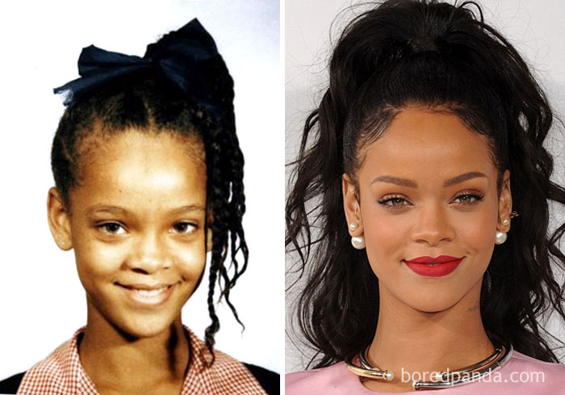
A message from the dark side of scripture... you have!
Who is this famous singer?
Things your Sunday School teacher didn’t teach you

Slide 11
A message from the dark side of scripture... you have!
Things your Sunday School teacher didn’t teach you

Slide 12
A message from the dark side of scripture... you have!
Activity 1
God sees our potential: Read Judges 6:11-16
Things your Sunday School teacher didn’t teach you
1. Has there been a time when someone gave you a job to do and you thought you couldn’t do it, but they believed that you could?
2. Why do you think Gideon was surprised when God called him a mighty warrior?
3. Look up Ephesians 2:20. and 2 Corinthians 12:9 What does it teach us about how we should view ourselves and what God can do for us?

Slide 13
A message from the dark side of scripture... you have!
Activity 2
Rely on God’s strength
Things your Sunday School teacher didn’t teach you
Play some arm wrestling OR have a go at this
https://www.quickflashgames.com/games/bar-challenge-1-arm-wrestling/

Slide 14
A message from the dark side of scripture... you have!
Activity 2
Things your Sunday School teacher didn’t teach you
READ: Judges 6: 14
1. What does “go in the strength you have” mean?
Whose strength did he have?
2. Look up Philippians 4:13. Whose strength do Christians have?
What does it mean for every day living?

Slide 15
A message from the dark side of scripture... you have!
True or false?
Activity 3
Things your Sunday School teacher didn’t teach you
The Channel Tunnel is 31.5 miles long
(True)
The world’s largest island is Greenland.
(True)
South America has more nations than Africa.
(False)
. Minnie Mouse’s real name is Minerva Mouse
(True)
In 1960, the World Wide Web was created.
(False)

Slide 16
A message from the dark side of scripture... you have!
“We Don’t Talk about Bruno”, the song from Encanto is the first Disney song to reach #1 on the Billboard Top 100 charts for 29 years.
(True)
West Side Story is a musical play based on Shakespeare’s Romeo and Juliet, that won the 1960 Oscar.
(True)
Pigs don’t like being cleaned and hence they roll in the mud.
(False)
Compared to a hydrogen atom, a carbon atom is lighter.
(False)
Things your Sunday School teacher didn’t teach you

Slide 17
A message from the dark side of scripture... you have!
Activity 3
Stand up against false gods and ideologies.
Read Judges 6:25-31.
1. What are the idols (untrue things) in this modern world that we
must stand against?
2. Even though Gideon tore down the idols at night so no one
would see, why was it still brave?
3. Read 1 John 5:21. What is the instruction?
Things your Sunday School teacher didn’t teach you

Slide 18
A message from the dark side of scripture... you have!
Activity 4
Seek God’s confirmation
Read Judges 6:36-40
1. Why did Gideon ask for signs to confirm God was speaking to him?
Is it okay to doubt?
2. How do we know today that God has called us to do something?
3. Lookup James 1:5 What must we do if we are unsure?
Things your Sunday School teacher didn’t teach you

Slide 19
A message from the dark side of scripture... you have!
Things your Sunday School teacher didn’t teach you
Psalm 119:105
“Your word is a lamp to my feet and a light to my path”

