Slide 1

Baptism

Slide 2
What is baptism?

Slide 3
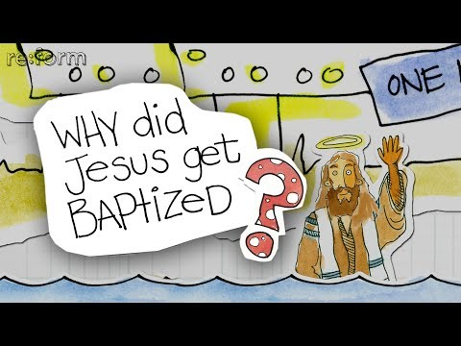

Slide 4
Matthew 3:1-6
What message did John the Baptist bring to the people?
What does “repent” mean?
What reaction did his message have from the people who heard it (verses 5-6)?

Slide 5
Matthew 3:7-10
Did John think the Pharisees and Sadducees had really repented?

Slide 6
Matthew 3:11-12
From verse 3 and verses 11-12, what was the other important message that John was bringing to the people?

Slide 7
Matthew 3:13-17
Why did John say he shouldn’t baptise Jesus?
If John was baptising people so they could “repent” of their sins, why was it strange that Jesus wanted to be baptised?
How did God the Father show his approval/pleasure of Jesus?

