Slide 1

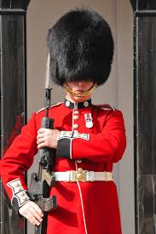



What the Bible says about how to be
Be on your guard…
Do not be deceived…
Be…

Slide 2
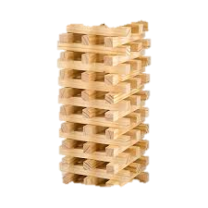
What the Bible says about how to be
Build a structure with Jenga… can the other team destroy it with their catapults and paper rocks?
WILL IT STAND FIRM?
Be…

Slide 3
What the Bible says about how to be
Activity 1
Read: 1 Corinthians 16:13
1. When a soldier is on guard. What do they do? What are they looking for/ protecting against?
2. What kind of things do you guard against?
3. What do you think Paul is talking about when he says to the church… “be on your guard?”
4. What does it look like to stand firm? How easy is it to resist temptation to let your faith slip? Look up Hebrews 4:12 and Ephesians 6:17… what do we need to do?
5. What kind of things sometimes tempt us to do things we know go against our faith?
Be…

Slide 4
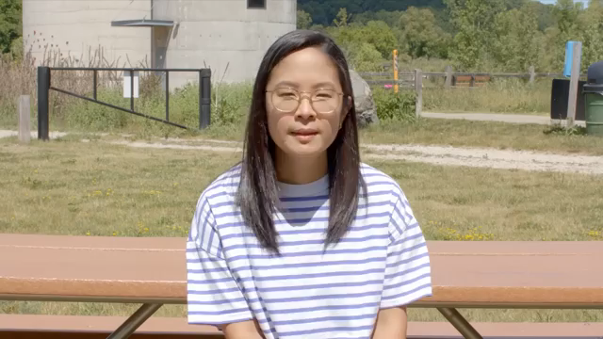
What the Bible says about how to be
Activity 2
Be…

Slide 5
What the Bible says about how to be
Activity 2
1. How did the woman explain the bible verse?
2. What short cuts in life do people desire or strive for? What do they do to try and achieve them?
3. What does the verse say about people who do this?
Be…

Slide 6

What the Bible says about how to be
Be…

Slide 7
What the Bible says about how to be
Activity 3
1. What were the ways to help people that Jesus mentioned?
2. What would that look like for you at school?
3. Can you think of examples when you have done some kind, generous act to help another?
4. What sometimes stops us being kind to others?
Be…

Slide 8
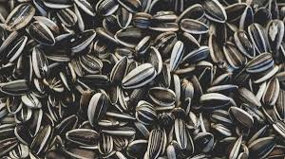

What the Bible says about how to be
Takeaway
Take some seeds… either plant them and watch them grow! Send me picture when they do.
OR
Keep them safe to remind you to sow good things in life
Be…

