Slide 1




What the Bible says about how to be…
Strong and courageous and not to be afraid
Be…

Slide 2

What the Bible says about how to be…
Test your strength!
How long can you stand with arms outstretched holding bibles?
Be…

Slide 3

What the Bible says about how to be…
Activity 1
Be…

Slide 4
What the Bible says about how to be…
Activity 1
1. What things do you worry about making a mess of?
2. Who knows the situation Joshua was in when God told him to be strong and courageous?
3. Do you think God told him to be strong and courageous just once or several times? Why?
4. When you make mistakes in life, how do you react?
5. Read Joshua 1:9 what should we do at all times? Why?
Be…

Slide 5

What the Bible says about how to be…
Activity 2
Be…

Slide 6
What the Bible says about how to be…
Activity 2
1. What made the disciples afraid?
2. Why were the initially frightened of Jesus?
3. What happened when Peter trusted Jesus?
4. What happened when he doubted?
5. What are the storms in our lives? How might trusting in Jesus help us deal with them?
6. Should we ever be fearful of difficult times? Why?
Be…

Slide 7
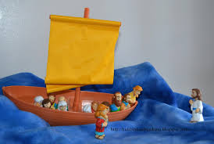
What the Bible says about how to be…
Activity 3
Make a model using Play Doh…
of the Bible story of Jesus and Peter walking on water
Be…

Slide 8

What the Bible says about how to be…
Takeaway
Take a sticker to remind you…
Be…

