Slide 1

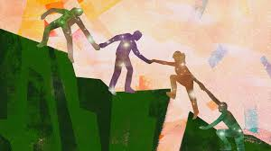


What the Bible says about how to be
Be sympathetic
Do not be proud… be willing…
Be…

Slide 2

What the Bible says about how to be
Be…

Slide 3
What the Bible says about how to be
Activity 1
What is the Christian life
1. How can you recognise a Christian person? Are there behaviours or attitudes that mark them out?
2. Read the following passages: 1 Peter 3:8-9, Romans 12:14-16
3. What are the different behaviours and attitudes a Christian should display?
4. How do these make you feel? Are they easy or difficult? Why?
5. Can you think of some “real life” examples of how living out these teachings would be difficult?
Be…

Slide 4
What the Bible says about how to be
Activity 2
“What would you sacrifice!”
Be…

Slide 5
What the Bible says about how to be
Activity 2
1. Read John 14:15-17
2. What does obedience to Jesus look like?
3. Who does Jesus promise to send to us as a help and support?
4. Will it cost you to follow Jesus?
Be…

Slide 6
What the Bible says about how to be
Activity 3
Is following Jesus worth it?
Look up the following verses:
Proverbs3:2 Psalm 119:2-3 1 Kings 2:3 I John2:17
John 14:21 James 1:25 Matthew 7:21
1. What are the benefits of obedience to God?
Be…

Slide 7
What the Bible says about how to be
What can I choose to do, that will cost me (a sacrifice of time, effort etc.) that will be obedient to Jesus’ teaching to “love your neighbour.”
Be…

