Slide 1

Becoming a Christian

Slide 2
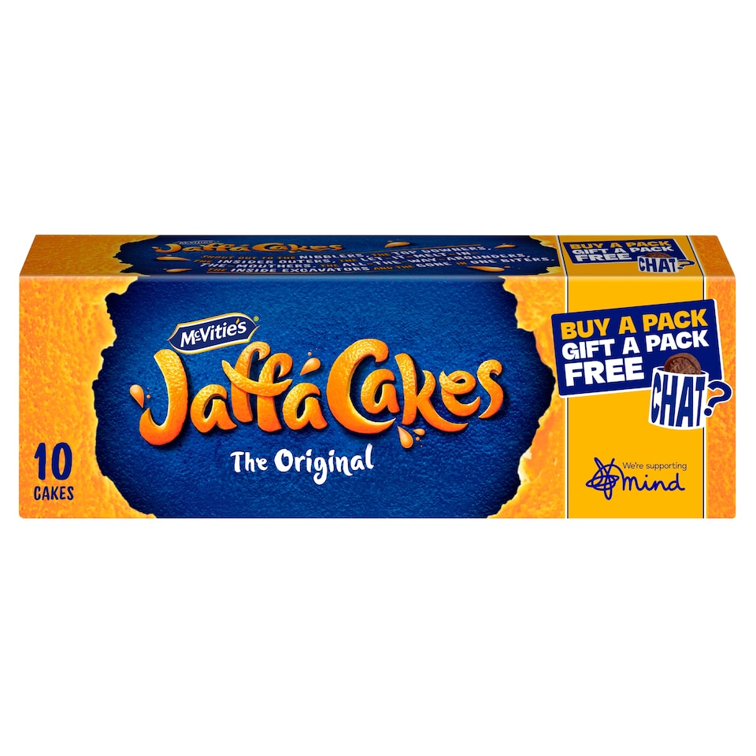
McVitie's Jaffa Cakes Original Biscuits 10 Pack 110g
£1.50

Slide 3

Tesco Cherries Punnet 200G
£3.00

Slide 4

Tesco 10 Garlic Bread Slices 260G
£1.20

Slide 5
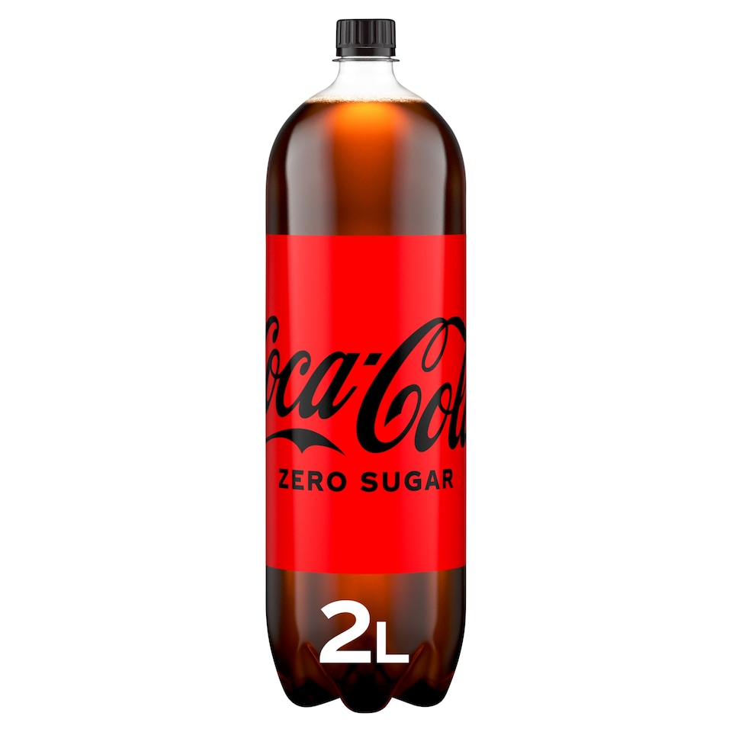
Coca-Cola Zero Sugar 2L
£2.15

Slide 6
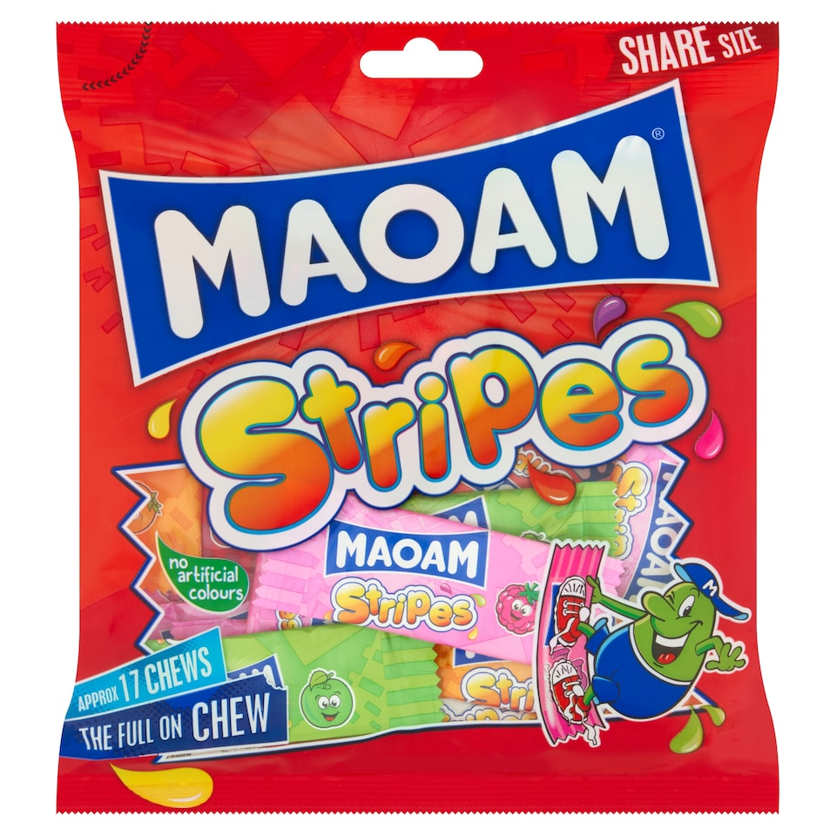
Maoam Stripes Bag 140g
£1.09

Slide 7
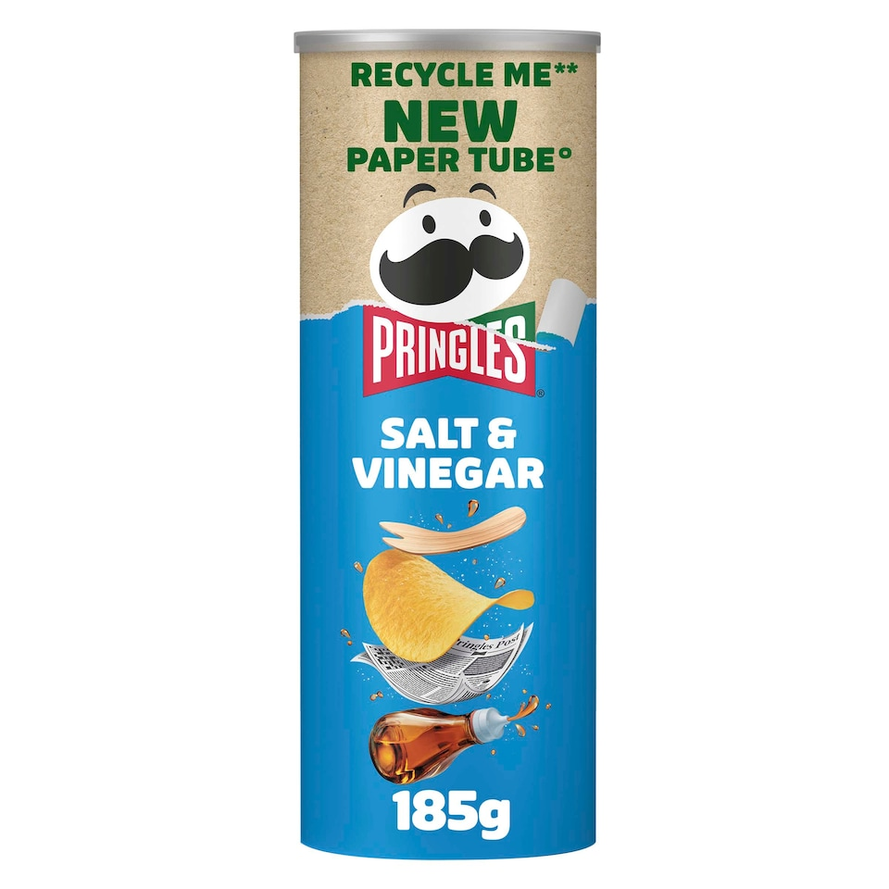
Pringles Salt & Vinegar Sharing Crisps 185g
£2.50

Slide 8
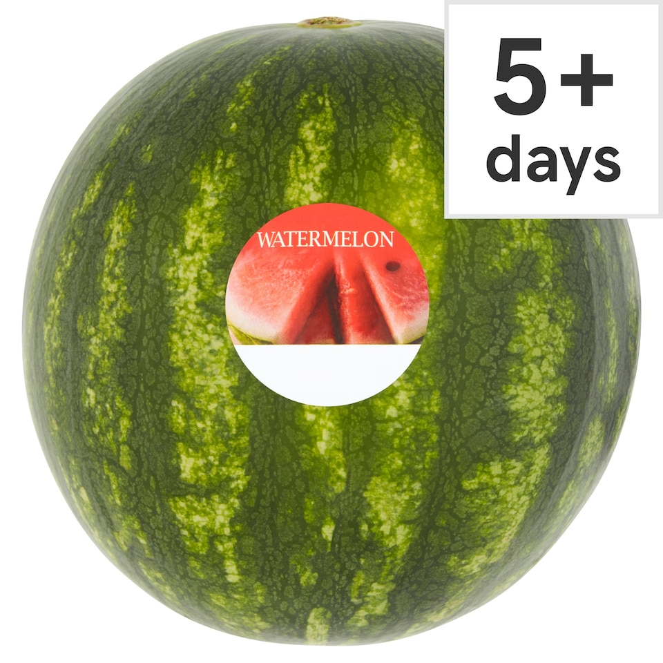
Tesco Watermelon
£3.50

Slide 9
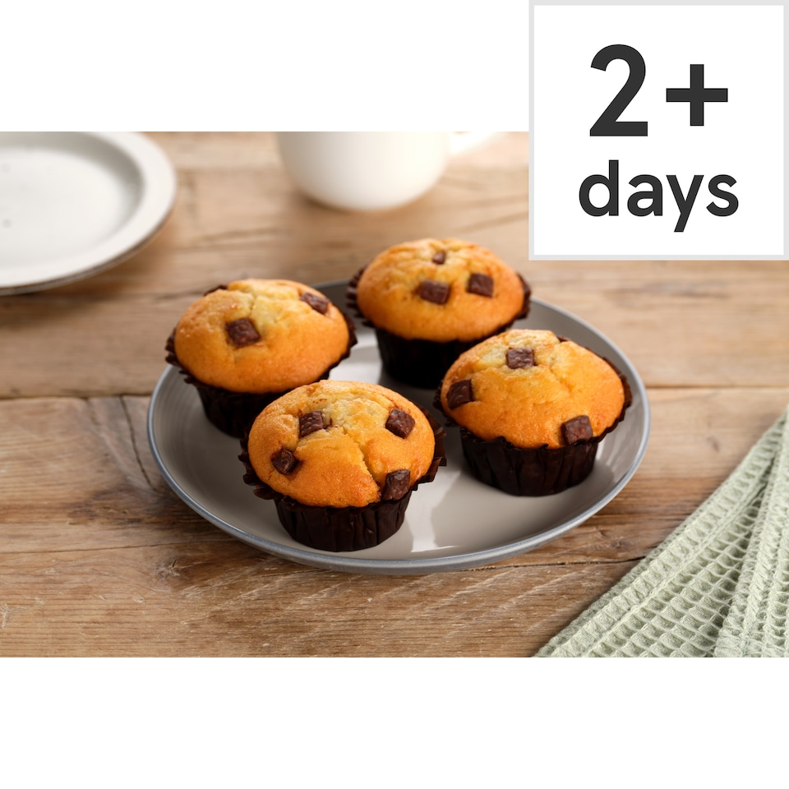
Tesco Chocolate Muffins 4 Pack
£1.80

Slide 10

Cube Box 48 Sheets
£2.25

Slide 11
Luke 19:1-10
1.What had Zaccheus done wrong in his life?
2. How do you think Zaccheus felt about his job and what people thought of him?
3. How did Jesus show love and acceptance to Zaccheus?
4. Having been forgiven by Jesus, how did Zaccheus show what difference that had made to his life?

Slide 12
Luke 19:1-10
What is it that separates us from God?
What do we need forgiveness for?

Slide 13
Acts 8:26-40 – Philip and the Ethiopian. Acts 9:1-22 – Saul. Acts 16:16-34 – The Jailer.
What happened before this person became a Christian?
What helped them become a Christian?
What difference did it make in their life?

Slide 14


How to become a Christian

Slide 15
You have heard…
Jesus is the son of God.
He died on a cross
He talked about God as His Father
He rose from the dead
He healed people and did allsorts of miracles

Slide 16
How to become a Christian
A
Acknowledge your sin and your need of God.
Believe in your heart that Jesus is Lord and that he died to save you from your sin.
Confess with your lips that you have decided to follow Christ
A

