Slide 1
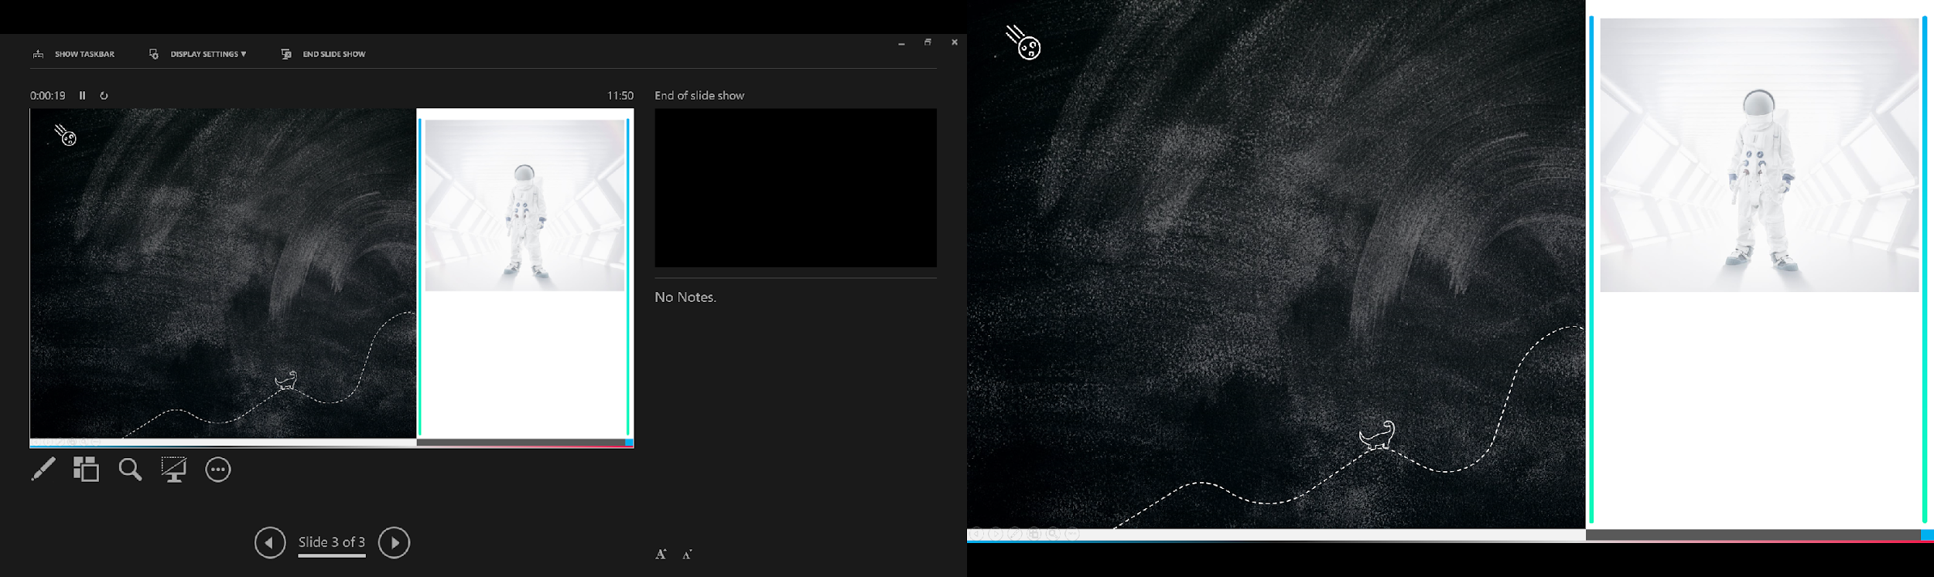


Slide 2

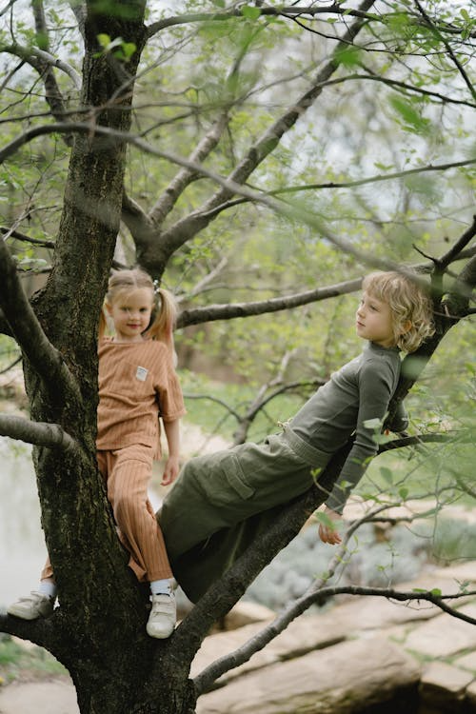

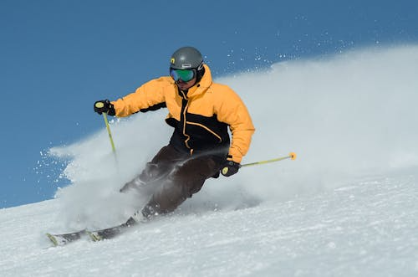

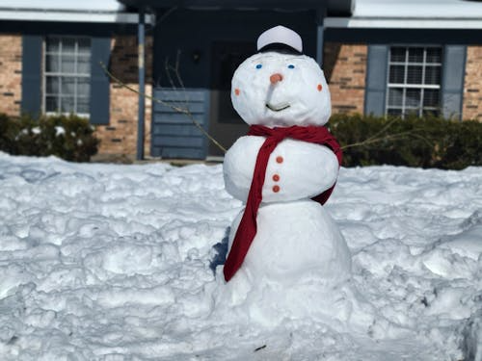

Slide 3

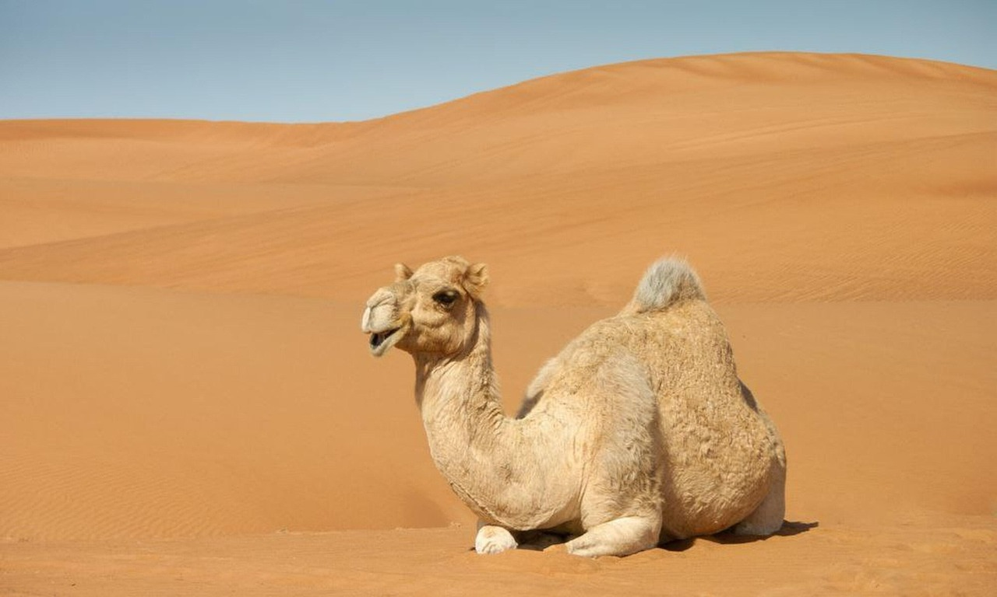




Slide 4

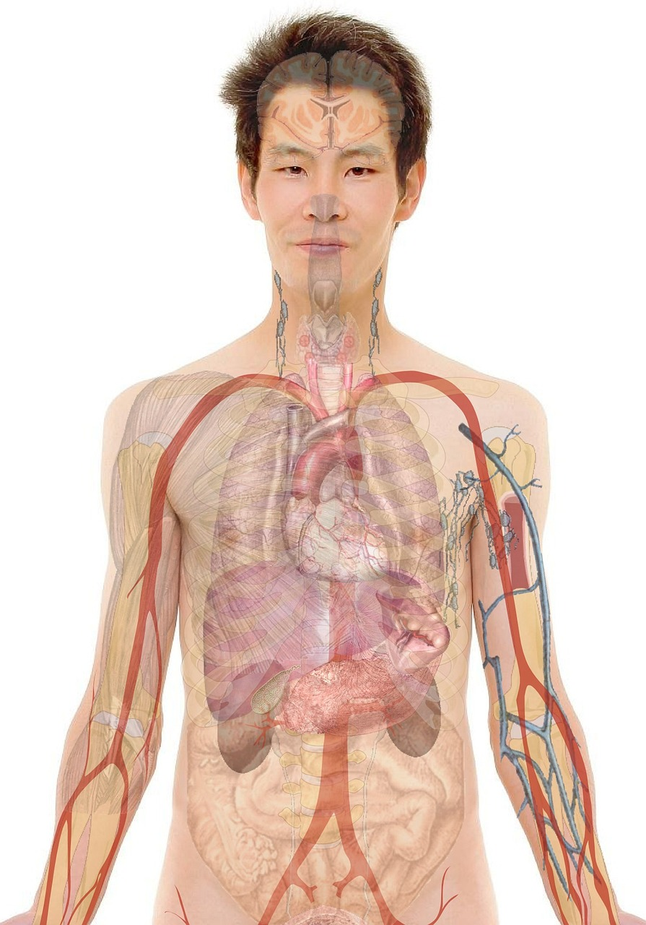

Slide 5
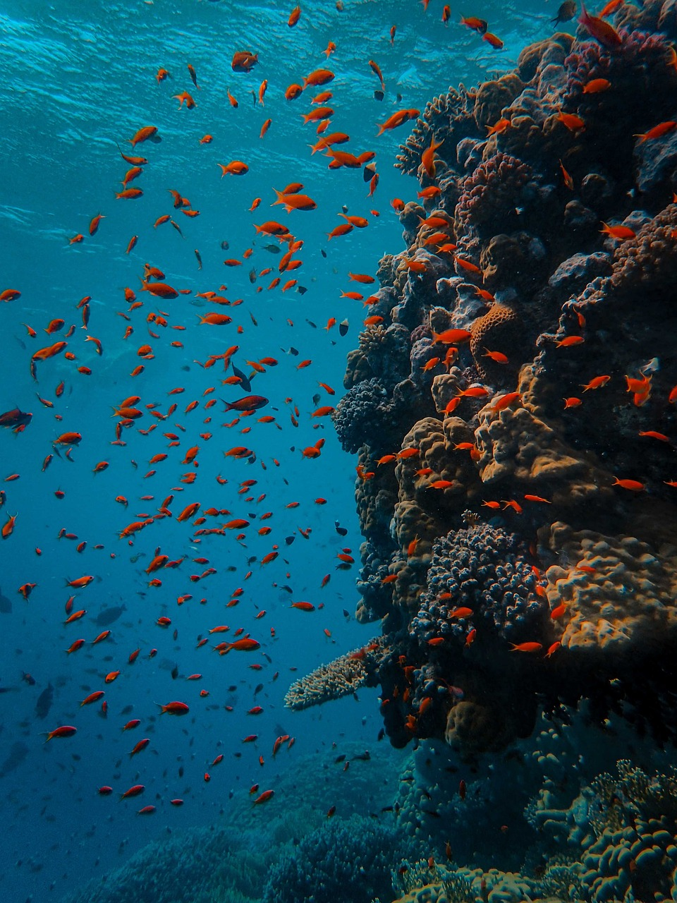
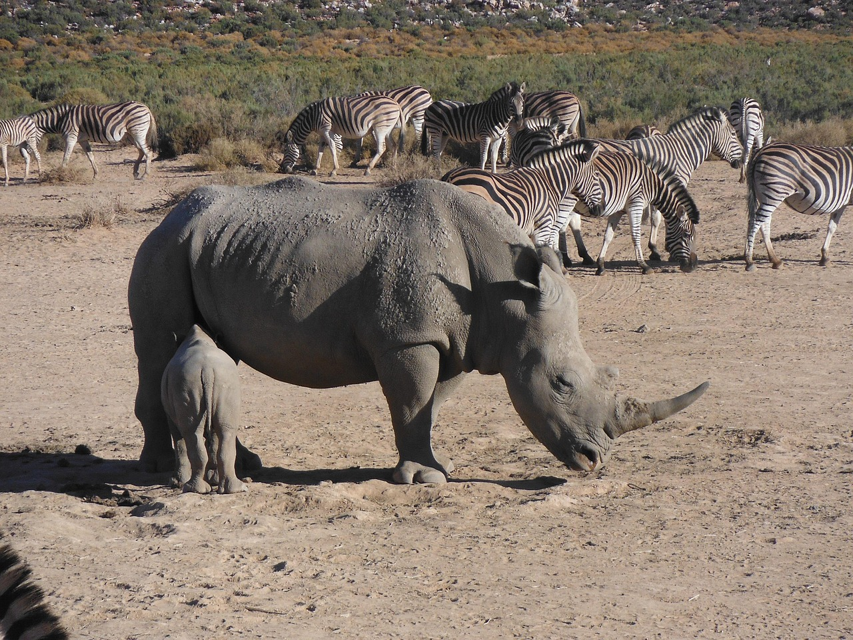
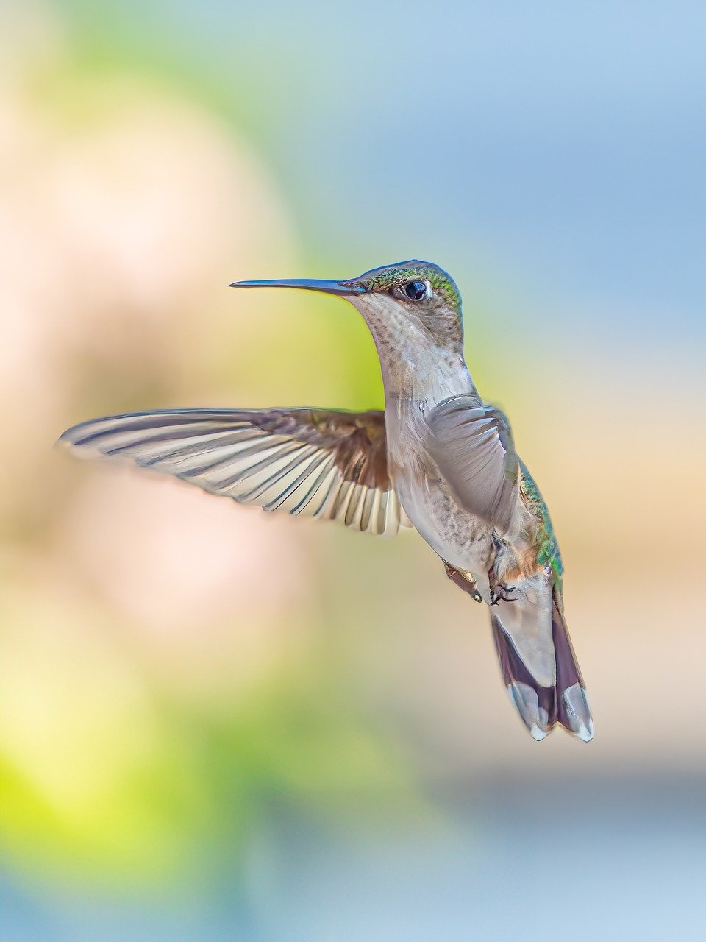
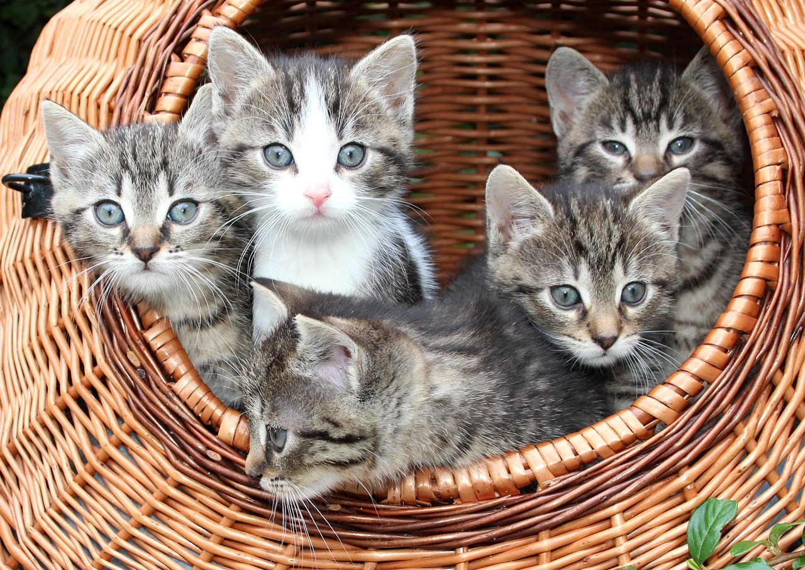

Slide 6
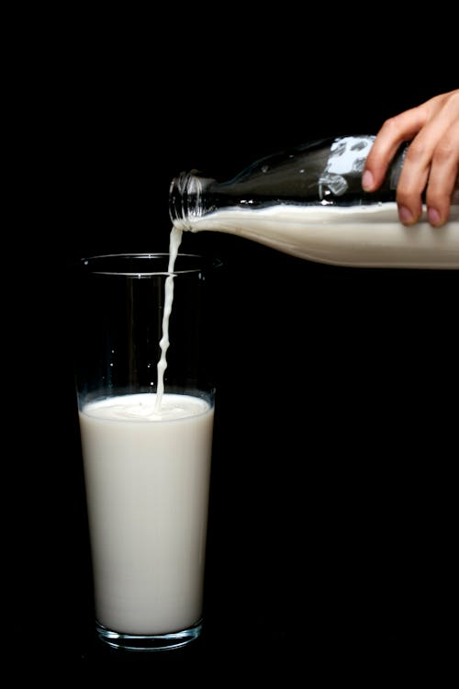

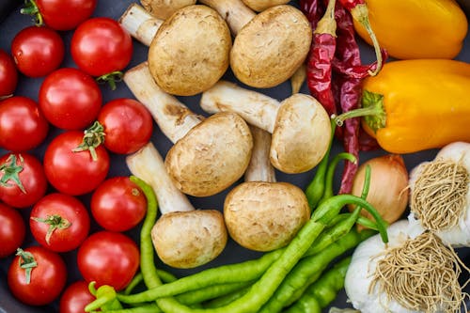
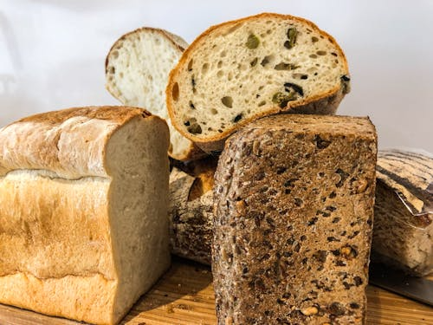

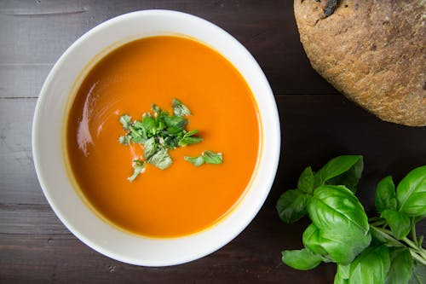


Slide 7
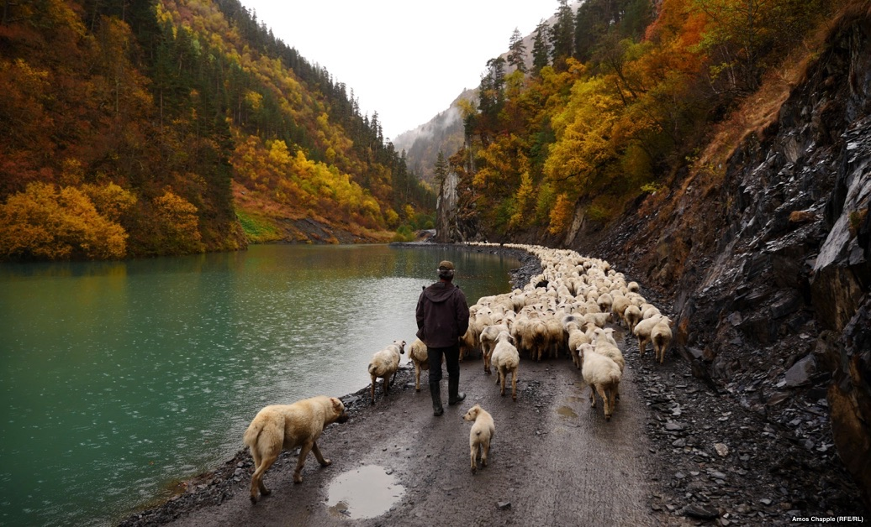
Psalm 23 ¹ The Lord is my shepherd; I have all that I need. ² He lets me rest in green meadows; he leads me beside peaceful streams. ³ He renews my strength. He guides me along right paths, bringing honour to his name. ⁴ Even when I walk through the darkest valley, I will not be afraid, for you are close beside me. Your rod and your staff protect and comfort me.

Slide 8
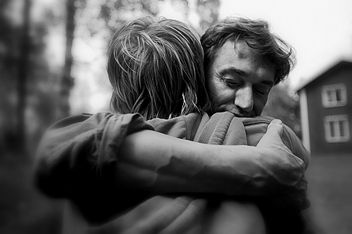
Parable of the Lost Son 11 To illustrate the point further, Jesus told them this story: “A man had two sons. 12 The younger son told his father, ‘I want my share of your estate now before you die.’ So his father agreed to divide his wealth between his sons. 13 “A few days later this younger son packed all his belongings and moved to a distant land, and there he wasted all his money in wild living. 14 About the time his money ran out, a great famine swept over the land, and he began to starve. 15 He persuaded a local farmer to hire him, and the man sent him into his fields to feed the pigs. 16 The young man became so hungry that even the pods he was feeding the pigs looked good to him. But no one gave him anything.

Slide 9
17 “When he finally came to his senses, he said to himself, ‘At home even the hired servants have food enough to spare, and here I am dying of hunger! 18 I will go home to my father and say, “Father, I have sinned against both heaven and you, 19 and I am no longer worthy of being called your son. Please take me on as a hired servant.”’ 20 “So he returned home to his father. And while he was still a long way off, his father saw him coming. Filled with love and compassion, he ran to his son, embraced him, and kissed him. 21 His son said to him, ‘Father, I have sinned against both heaven and you, and I am no longer worthy of being called your son.[b]’

Slide 10
22 “But his father said to the servants, ‘Quick! Bring the finest robe in the house and put it on him. Get a ring for his finger and sandals for his feet. 23 And kill the calf we have been fattening. We must celebrate with a feast, 24 for this son of mine was dead and has now returned to life. He was lost, but now he is found.’ So the party began. 25 “Meanwhile, the older son was in the fields working. When he returned home, he heard music and dancing in the house, 26 and he asked one of the servants what was going on. 27 ‘Your brother is back,’ he was told, ‘and your father has killed the fattened calf. We are celebrating because of his safe return.’

Slide 11
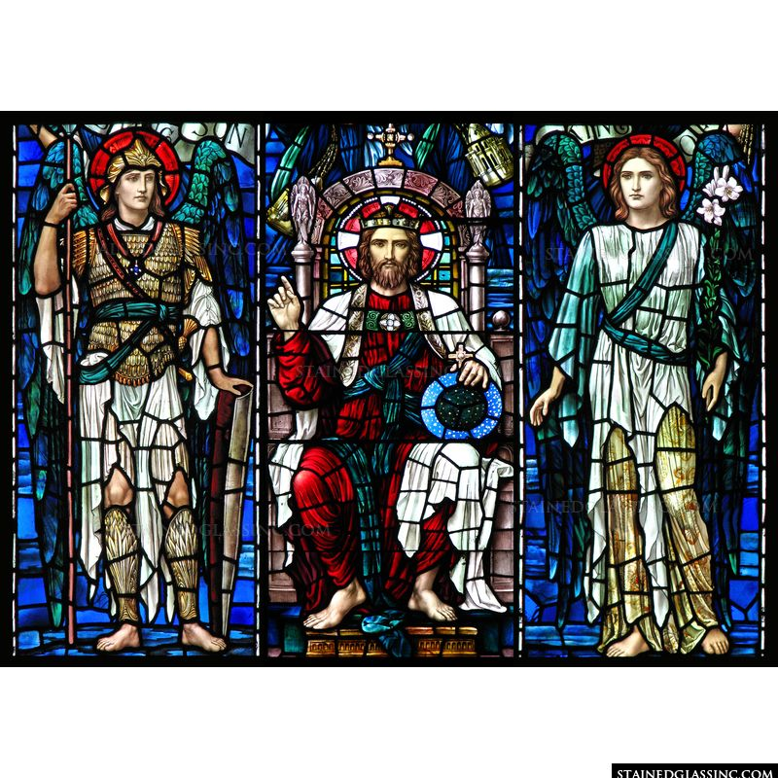
Isaiah 6 It was in the year King Uzziah died that I saw the Lord. He was sitting on a lofty throne, and the train of his robe filled the Temple.² Attending him were mighty seraphim, each having six wings. With two wings they covered their faces, with two they covered their feet, and with two they flew. ³ They were calling out to each other, “Holy, holy, holy is the Lord of Heaven’s Armies! The whole earth is filled with his glory!”⁴ Their voices shook the Temple to its foundations, and the entire building was filled with smoke. ⁵ Then I said, “It’s all over! I am doomed, for I am a sinful man. I have filthy lips, and I live among a people with filthy lips. Yet I have seen the King, the Lord of Heaven’s Armies.”

