Slide 1




What the Bible says about how to be
Do NOT be misled
Do NOT be overcome by evil…
Be…

Slide 2

What the Bible says about how to be
Be…

Slide 3
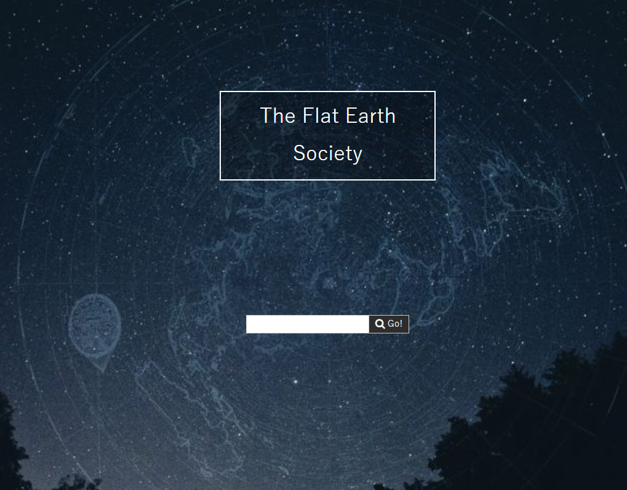
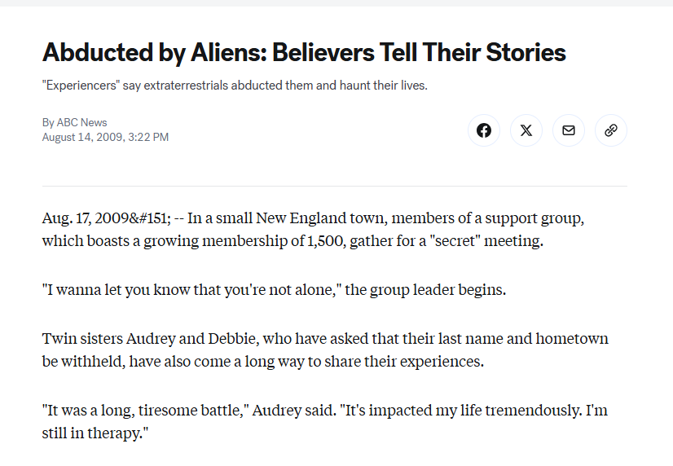
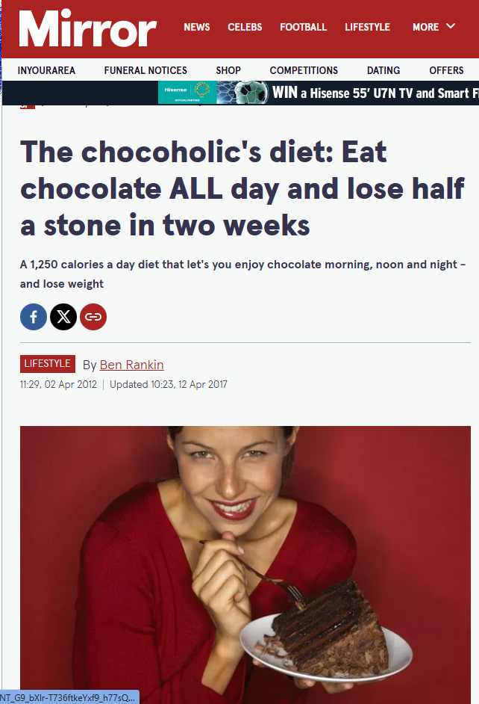
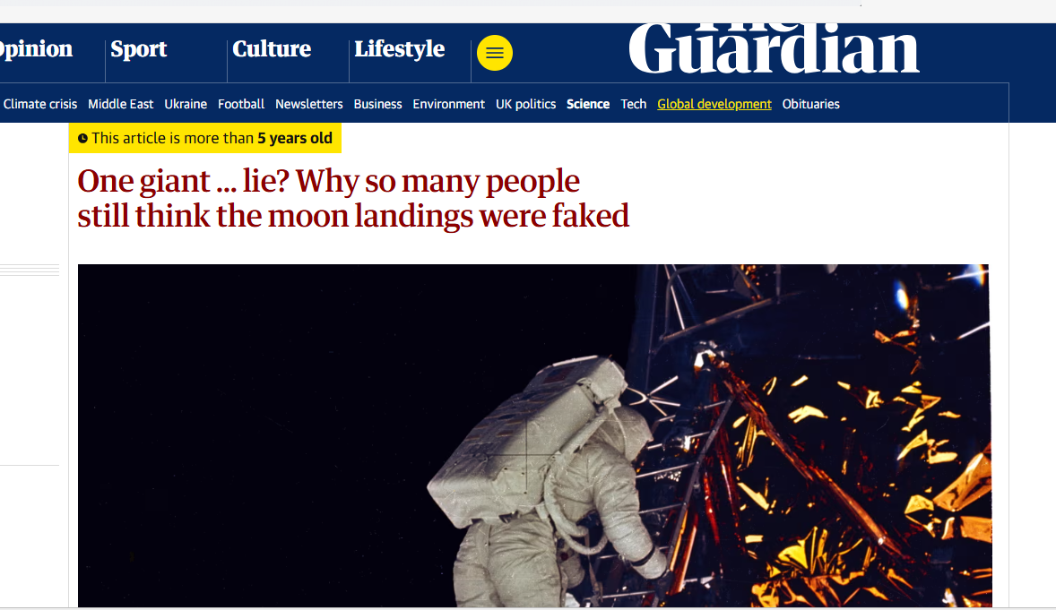
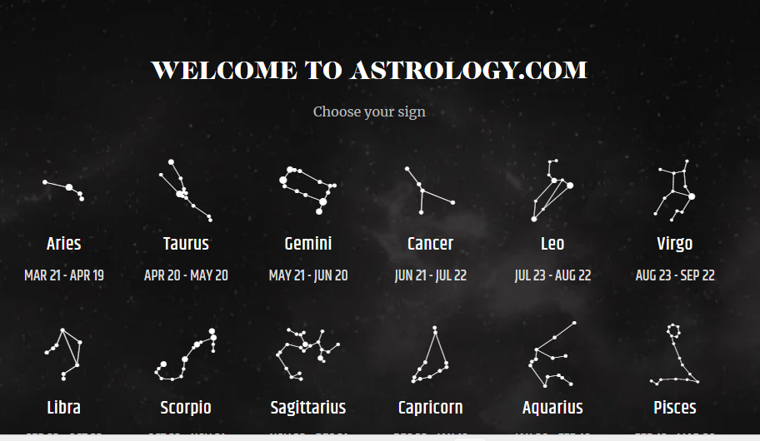
What the Bible says about how to be
Be…

Slide 4
What the Bible says about how to be
Activity 1
1. What do you think of them? Why? What other “strange” beliefs do people have?
2. How do you know who to believe?
Be…

Slide 5
What the Bible says about how to be
Activity 1
3. Look up Matthew 7:15-20. What does Jesus say about what we should believe?
4. What does He mean by wolves in sheep’s clothing?
5. How can we tell if a belief is genuine or not? What does Jesus say?
6. Look up 1 Corinthians 15:33-34. The context is people telling lies about the resurrection. What does Paul say?

Slide 6

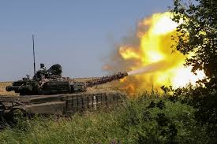





What the Bible says about how to be
Activity 2
Be…

Slide 7
What the Bible says about how to be
Activity 2
Read the whole of Romans 12 (have printed copy available to hand out)
Use highlighter of different colours to identify
1. Things Paul/God want us to do/say/think
2. Things we should not do/say/think
Be…

Slide 8
What the Bible says about how to be
Activity 2
Feedback What does living a Christian life look like?
1.What do you think v 2 means?
2. Read v21… How do we avoid being overcome by evil ?
Be…

Slide 9
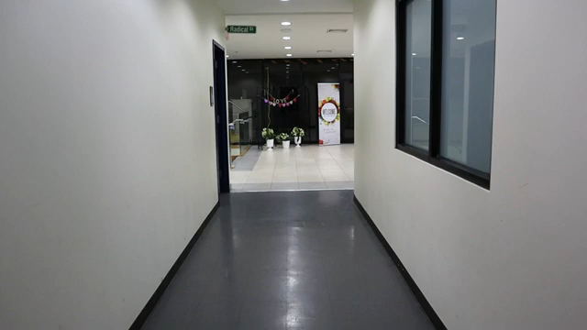
What the Bible says about how to be
Takeaway
Be…

Slide 10
What the Bible says about how to be
Close in prayer
Be…

