Slide 1


Slide 2
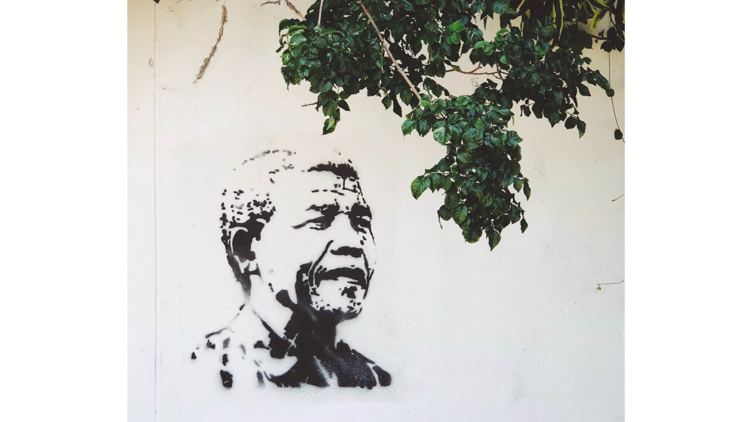

Slide 3
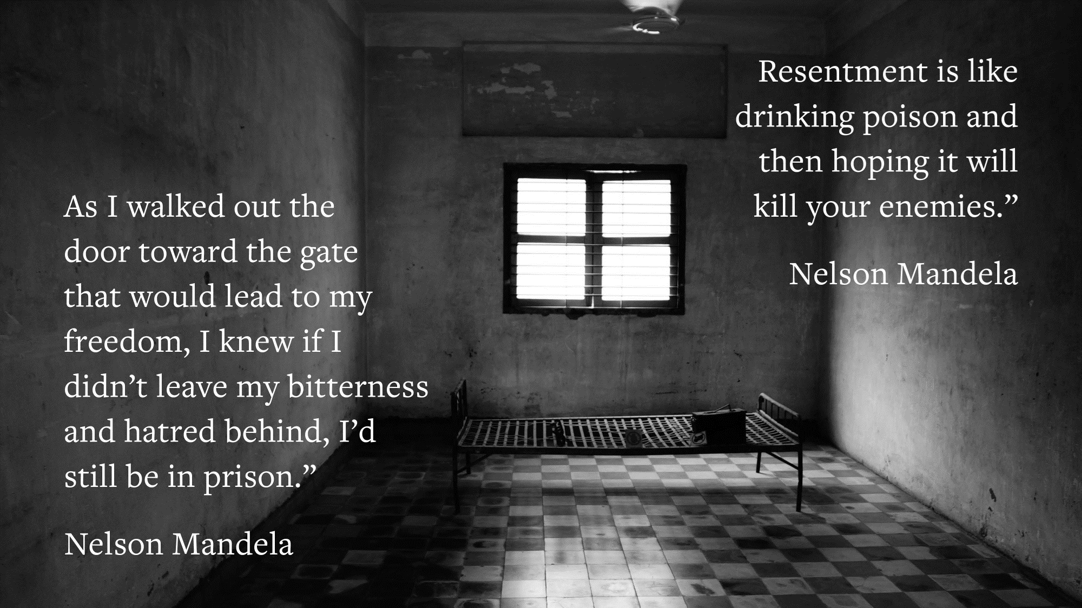

Slide 4

Why do people find it hard to forgive or not seek revenge?
What stops us from doing it?

Slide 5
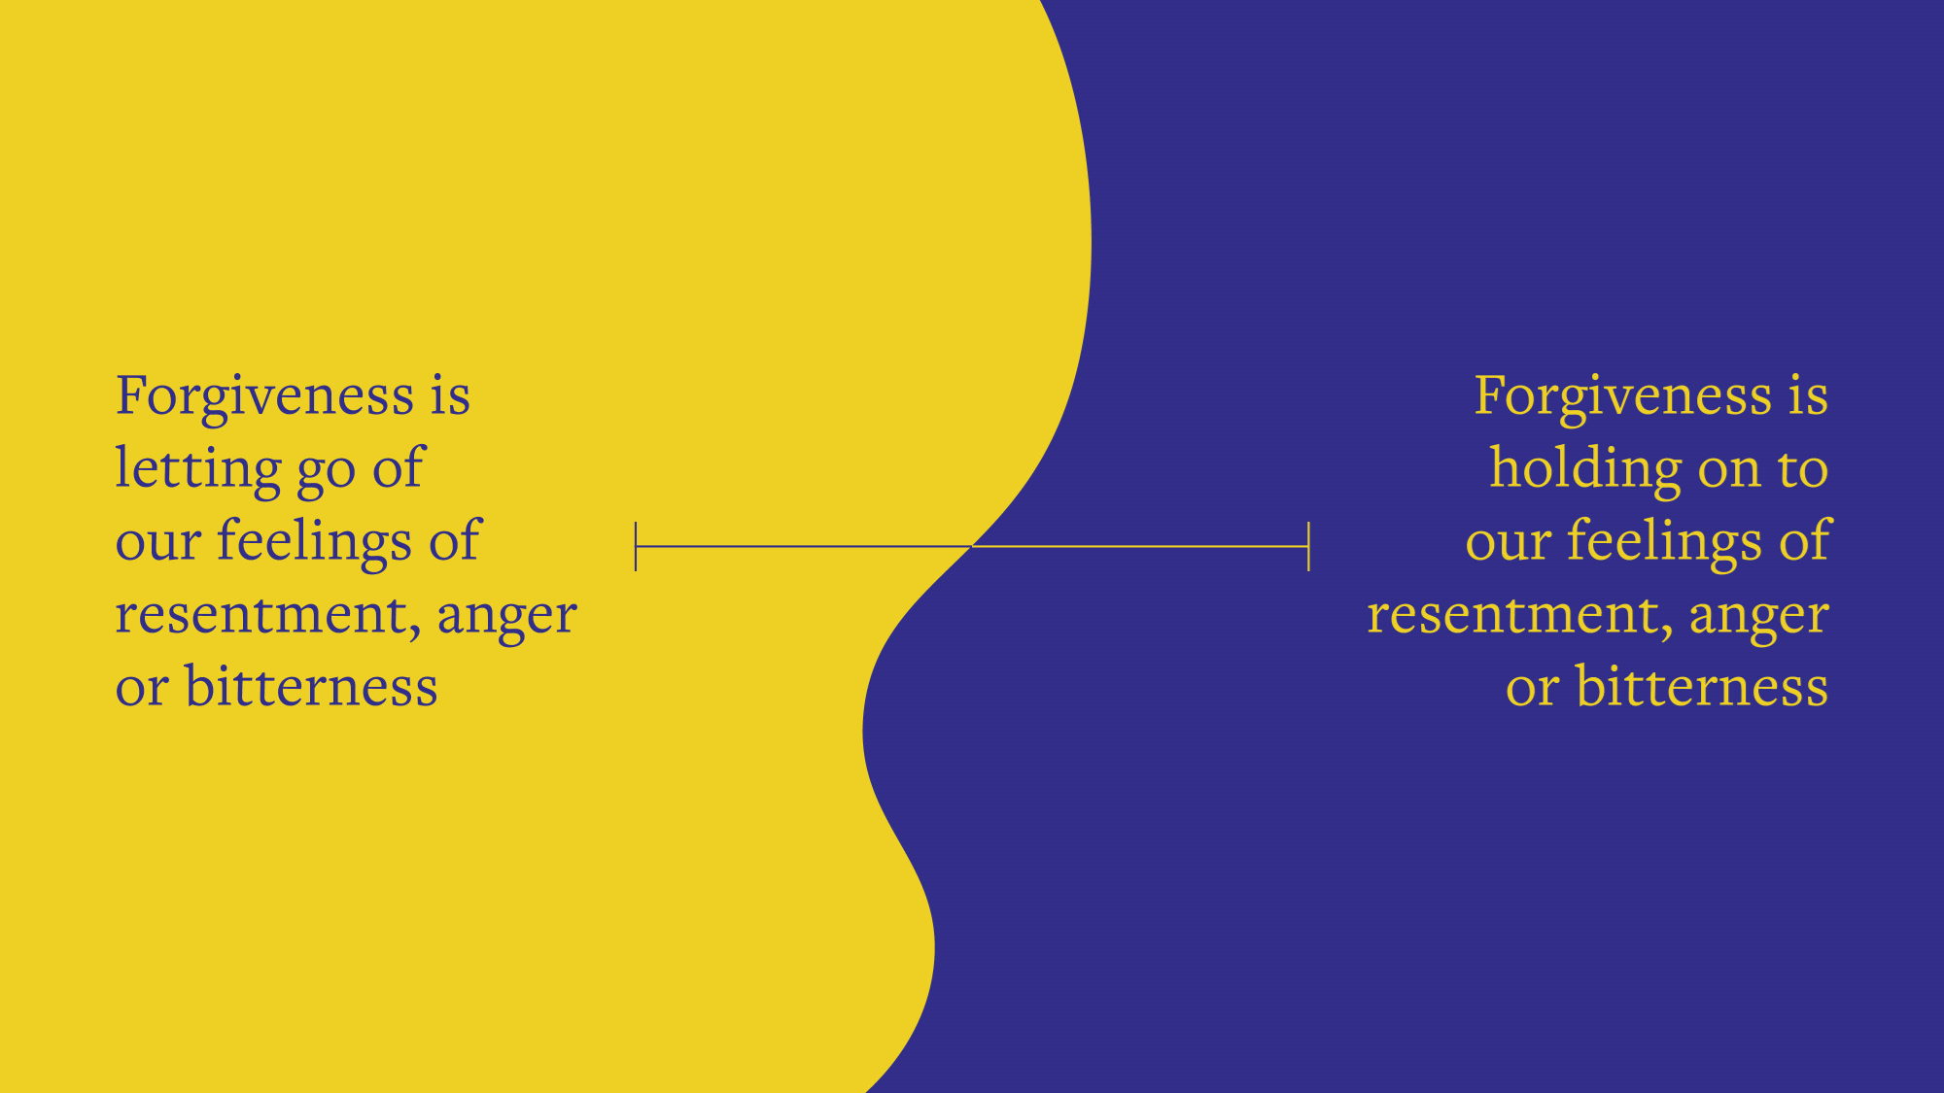

Slide 6
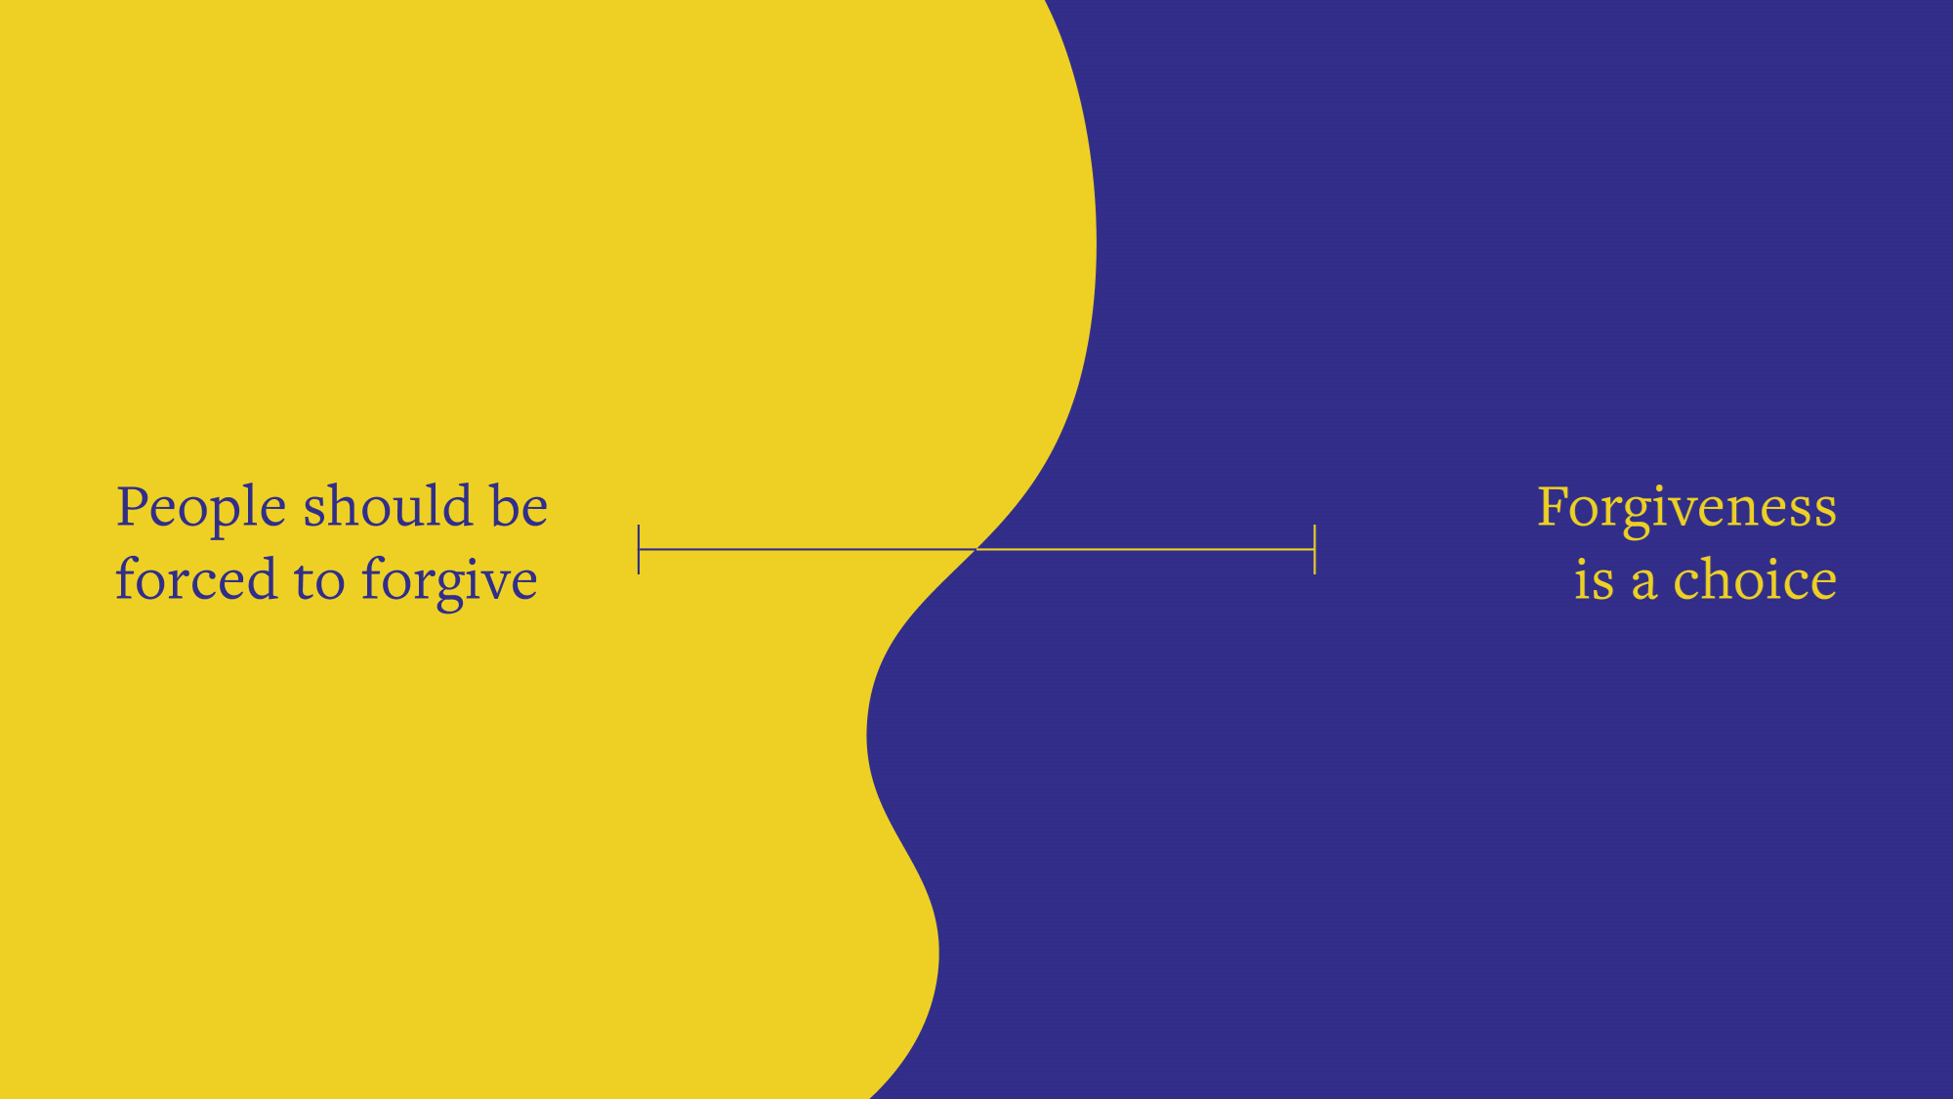

Slide 7
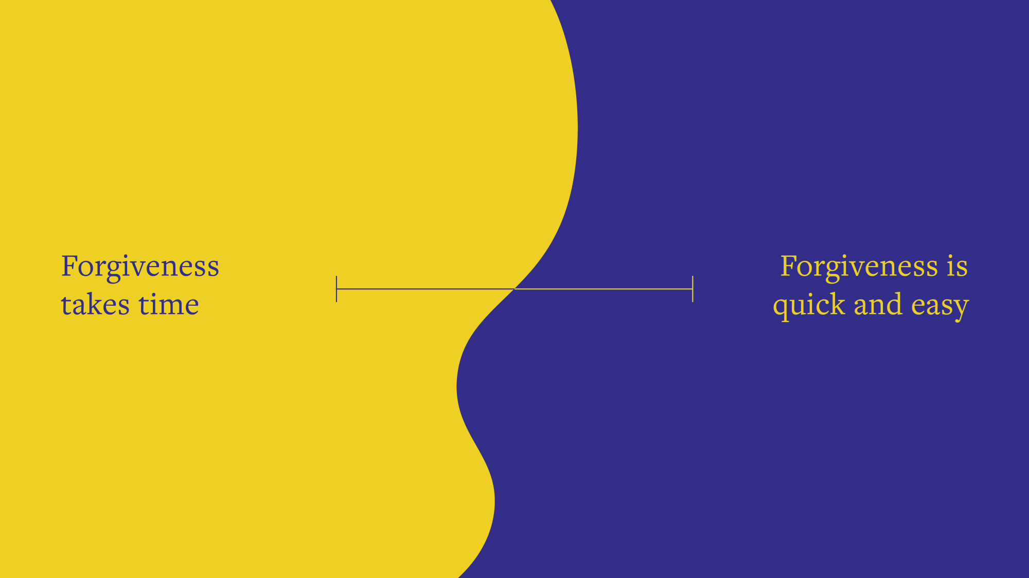

Slide 8
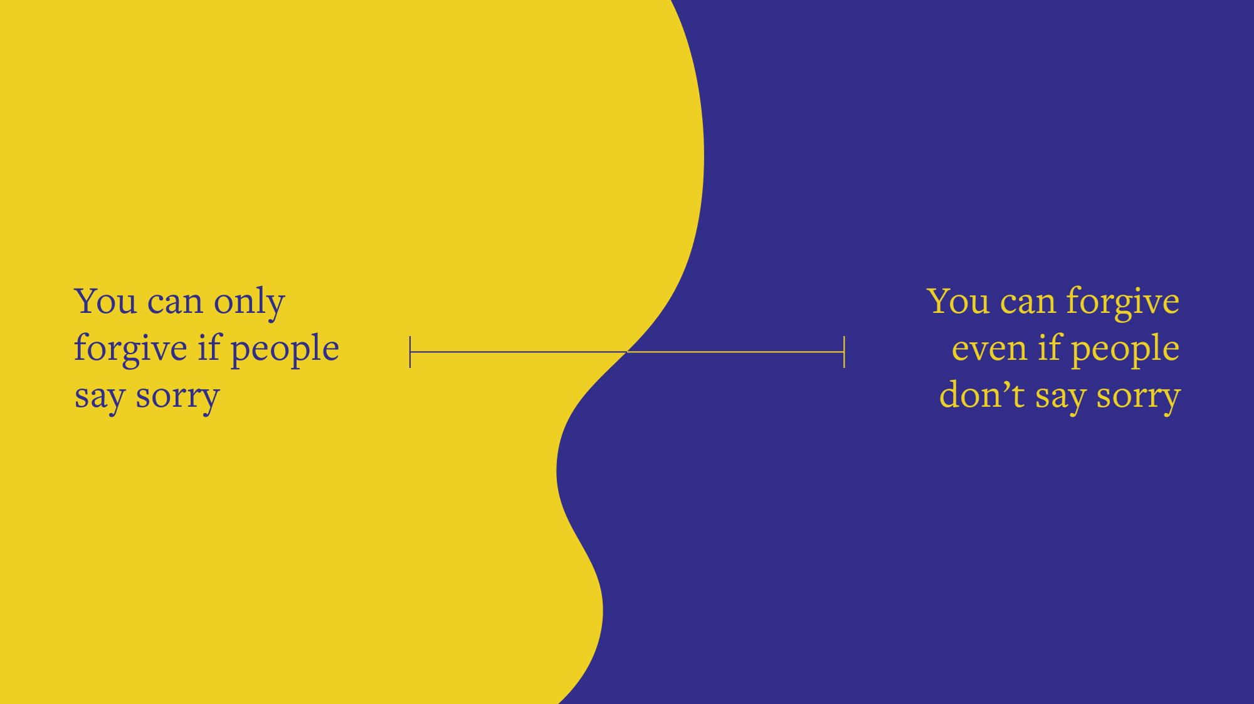

Slide 9

We, though, are going to love—love and be loved. First we were loved, now we love. He [God] loved us first...
...The command we have from Christ is blunt: Loving God includes loving people. You’ve got to love both.
1 John 4:19-21 The Message
Do you think this Bible passage suggests anything about forgiveness?

Slide 10


Slide 11
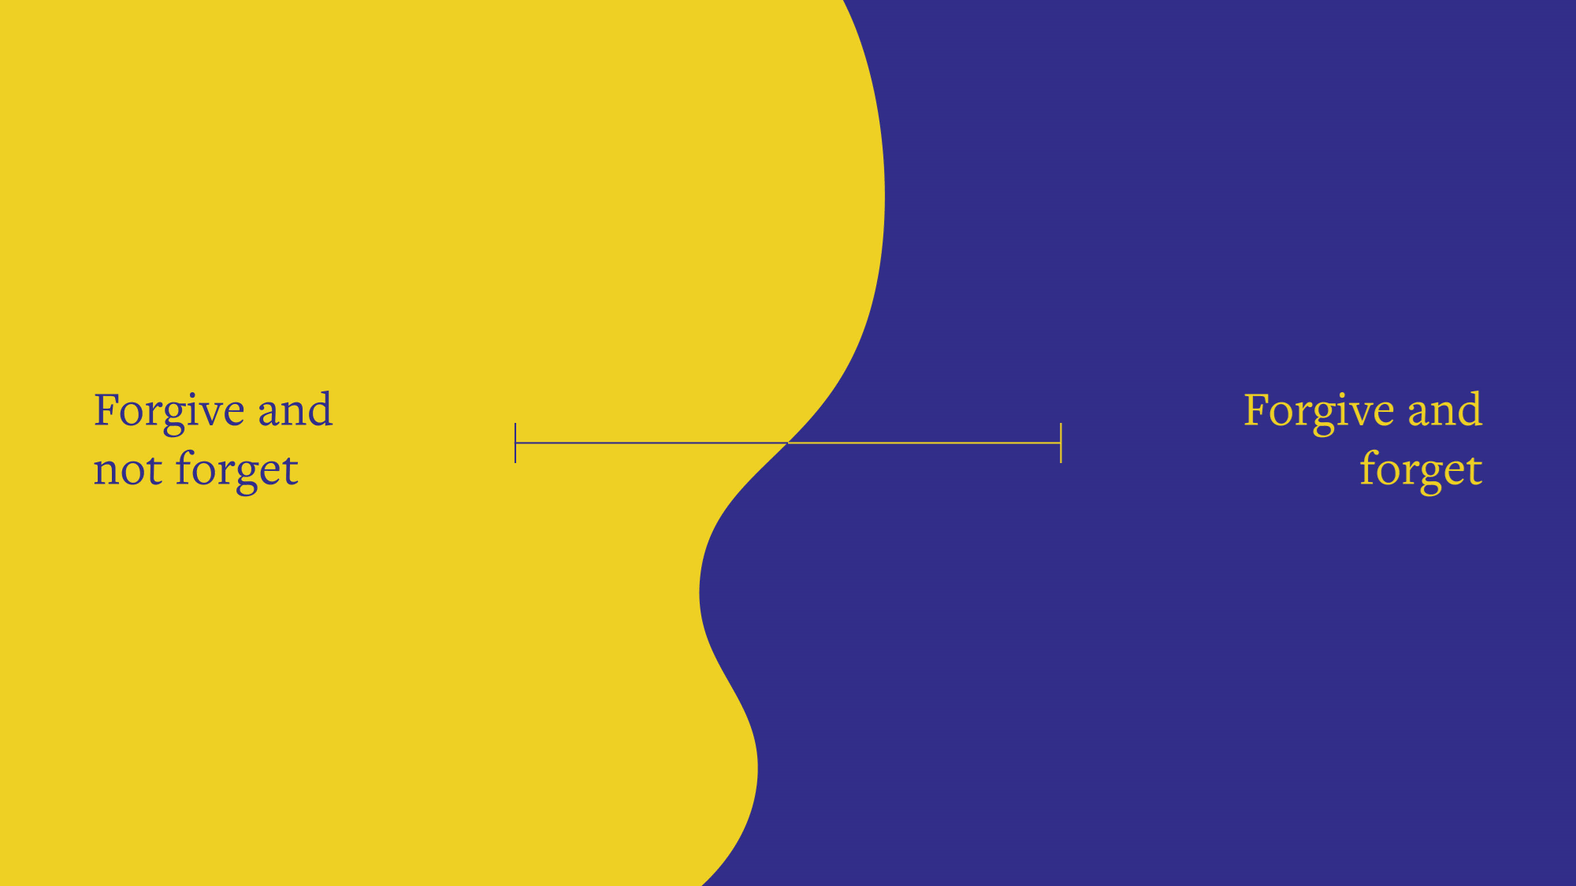

Slide 12
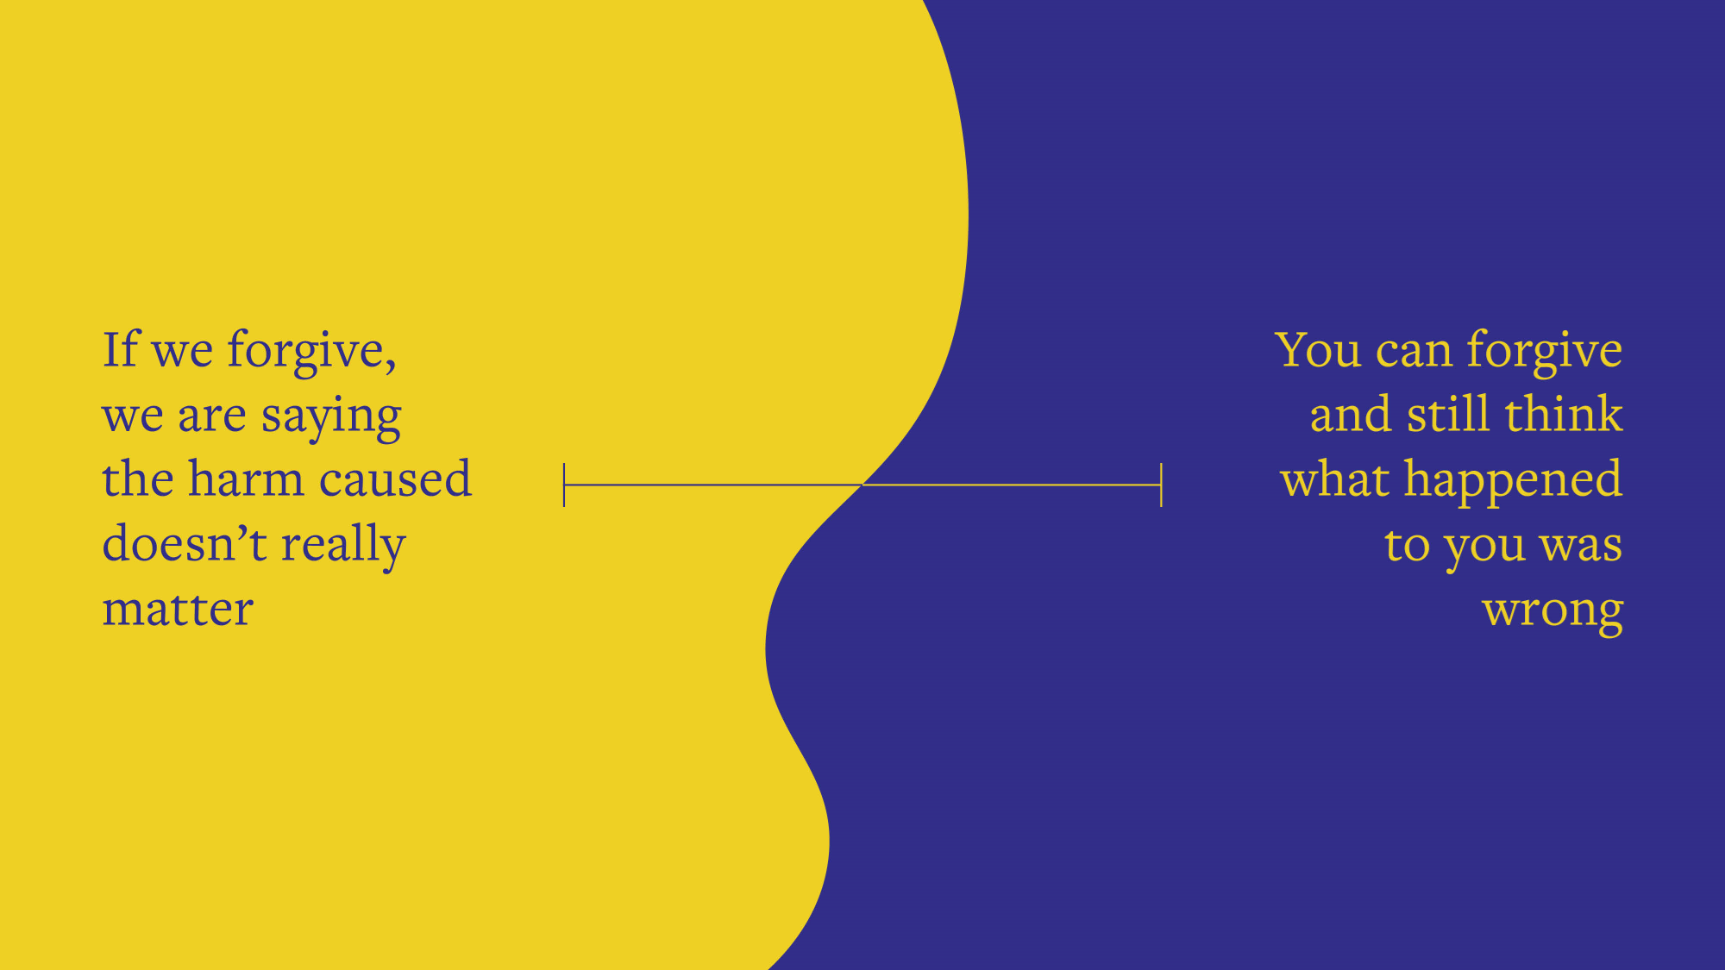

Slide 13
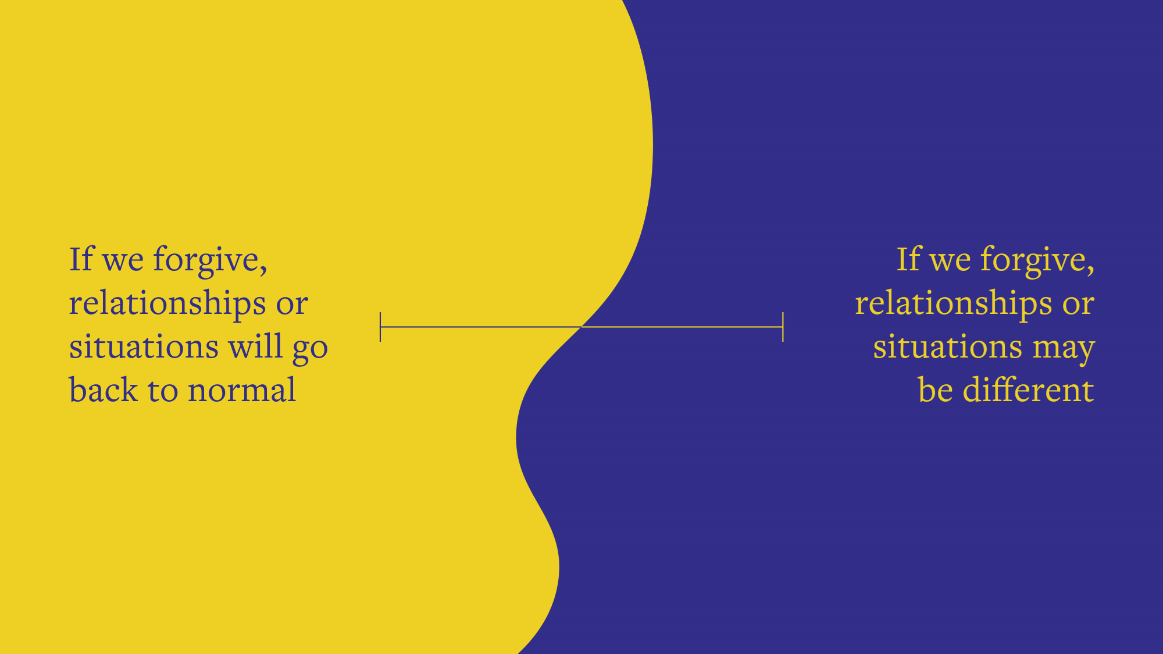

Slide 14
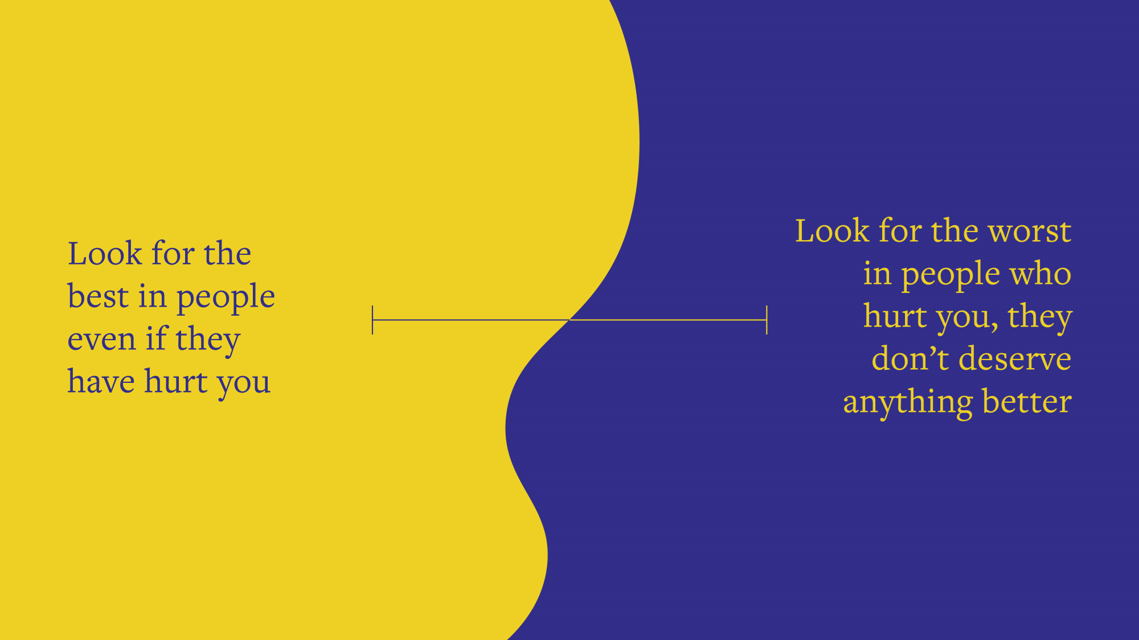

Slide 15
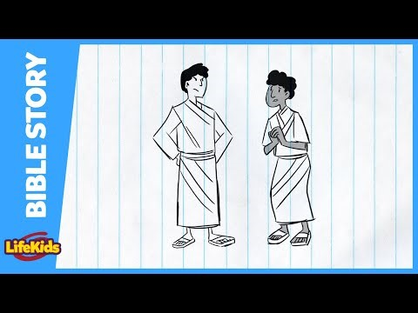

Slide 16

FORGIVING OURSELVES

Slide 17

How do people feel when they mess up?
What are some of the responses we can have to our mistakes?

Slide 18

What are some helpful things we could do and say to ourselves when we mess up?

Slide 19

1. EVERYONE MAKES MISTAKES

Slide 20

2. YOU MAY NEED TO APOLOGISE OR CORRECT YOUR MISTAKE

Slide 21
3. TALK TO SOMEONE ABOUT YOUR MISTAKE

Slide 22

4. TRY TO AVOID MAKING YOURSELF
feel better in ways that are
not helpful

Slide 23

5. LIVE OUT YOUR FORGIVENESS BY
PUTTING THE SITUATION BEHIND
YOU AND GETTING ON WITH LIFE.

Slide 24

Jeremiah 31:34 MSG
[God says]
“...I’LL WIPE THE SLATE CLEAN FOR EACH OF THEM.
I’LL FORGET THEY EVER SINNED!”

