Slide 1
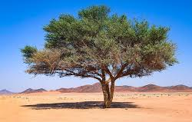
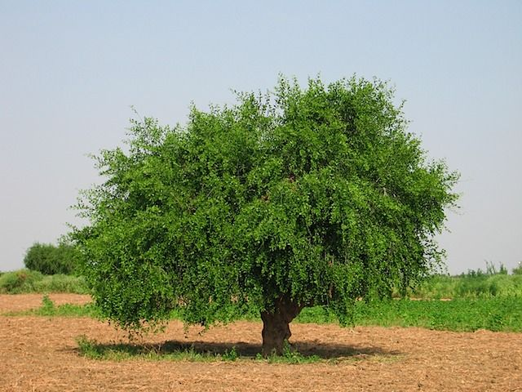
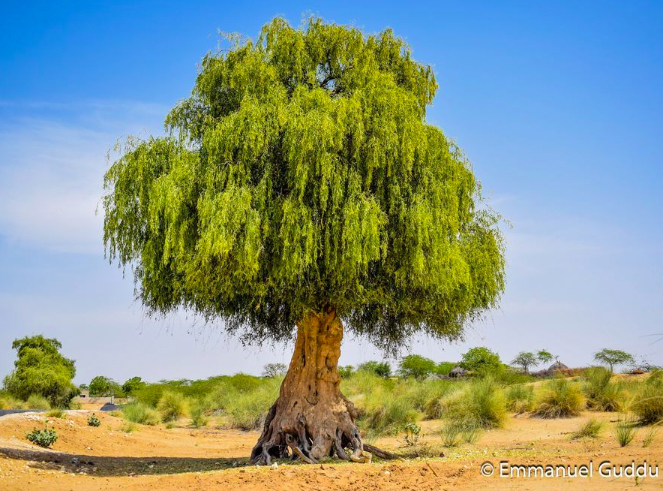
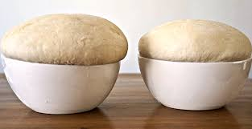
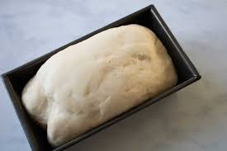
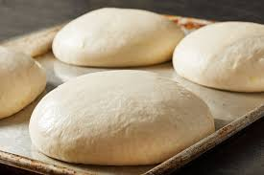
The Parables of the mustard seed and the yeast. Matthew 13:31-35
.

Slide 2
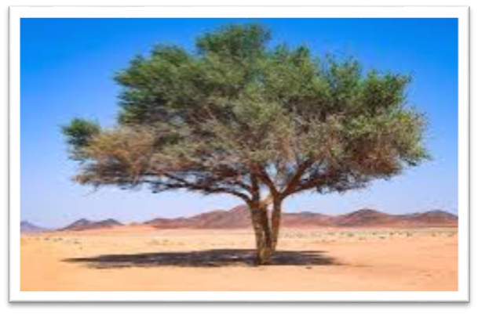
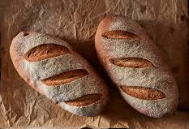
Why are we making popcorn?
Playdough challenge!
Make a mustard tree or a loaf of bread
Prizes for the best!

Slide 3
Let’s read Matthew 13:31-35
Activity 1
1. Why do you think Jesus told these parables? What
do you think He was trying to teach us?
2. Have you always been the way you are now, or have
you changed? Will you always be the way you are
now?

Slide 4
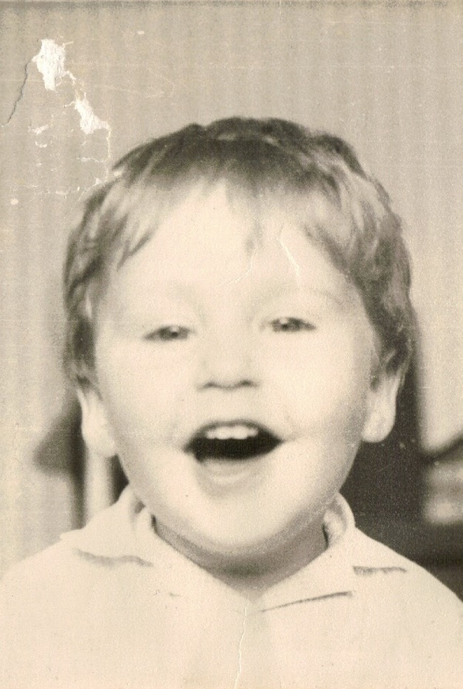
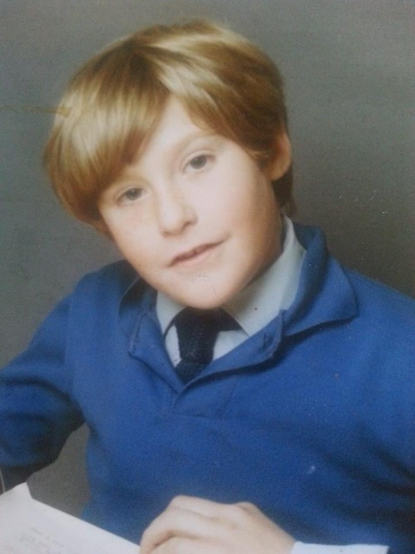
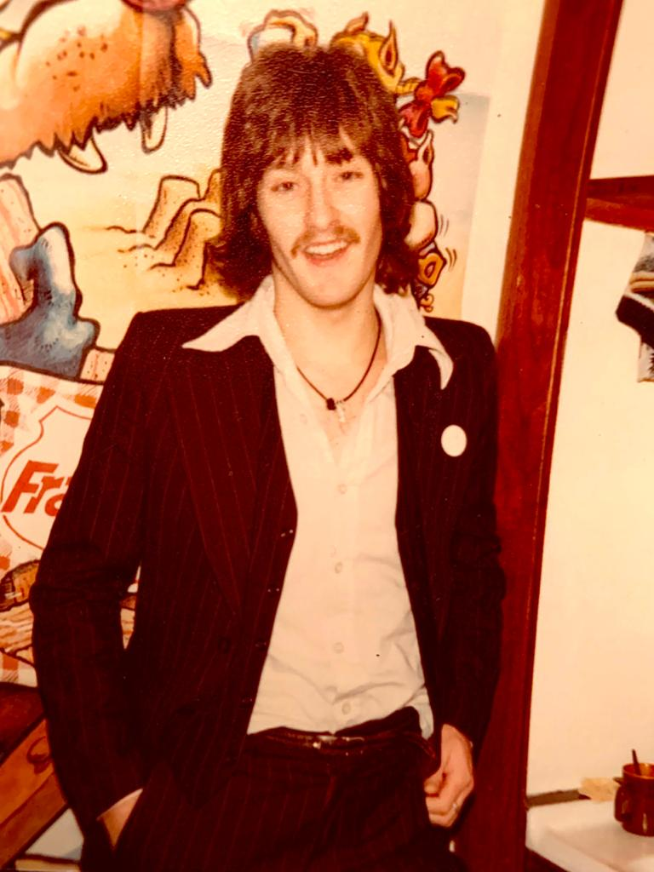
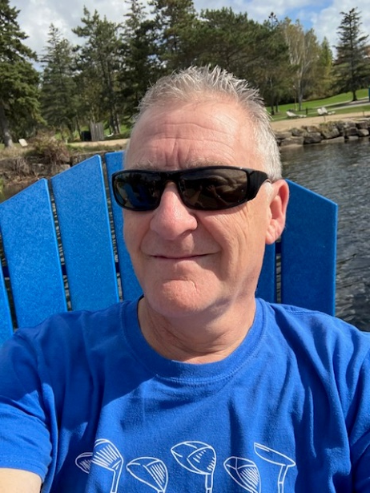
Who is this?
Activity 1
Jez

Slide 5
What makes you feel small and insignificant?
Activity 2
Do you ever feel like you are a mustard seed in this big world? If so, how?

Slide 6
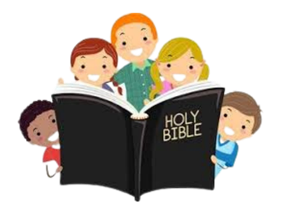
Activity 2
Look up these verses… what do they reveal about how we are valued by God?
Psalm 139:13-16 Romans 5:8 Matthew 6:25 Jeremiah 29:11 Genesis 1:27
Isaiah 43:4 Matthew 10:31 Ephesians 2:49 John3:16
Hebrews 4:16

Slide 7
Balloon challenge
Activity 3
When you become a Christian God fills you with His Holy Spirit. He can then use you to build and grow his kingdom!

Slide 8
Activity 3
Think about how these apply to you… then discuss the answers together
1. How can God use your life in His kingdom?
2. Why do you think Jesus uses people to grow His kingdom?
3. What are some things that get in the way of you making an
impact for the kingdom of God?
4. Does God equip you with everything you need to accomplish His
work?
5. Where do we get our strength to help grow the kingdom?
6. What are some ways you can make an impact for the kingdom?

Slide 9
Takeaway.
We may be one small individual in God’s kingdom but we are powered by the Holy Spirit who enables us to do great things for God. God’s kingdom will always grow and can never be stopped. You are a part of that if you love Jesus.

