Slide 1
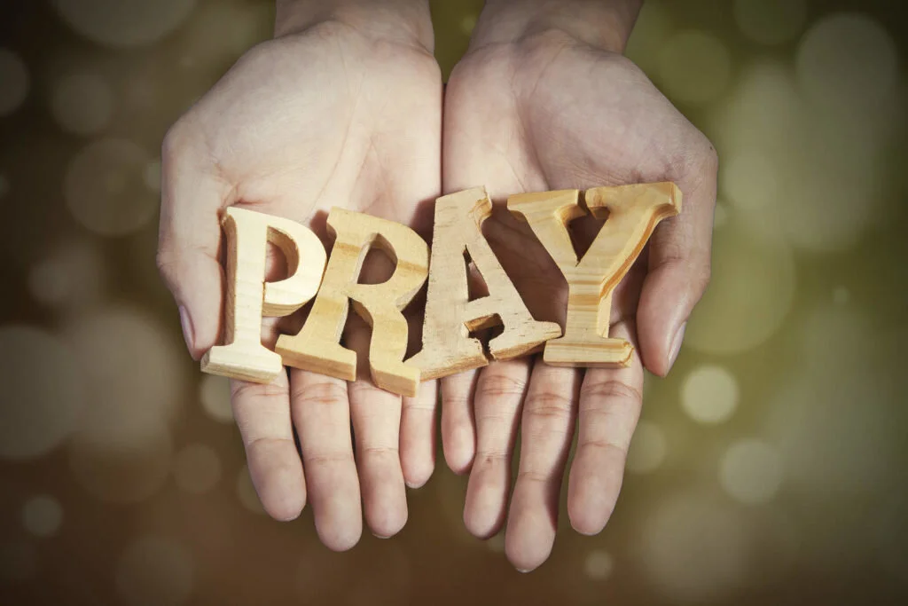

Slide 2
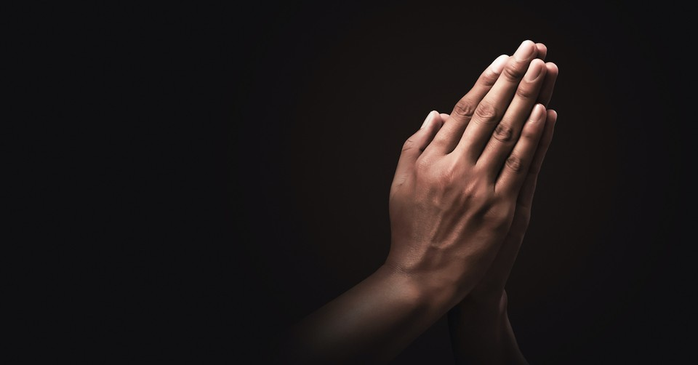
Why Pray?

Slide 3

Philippians 4:12-13
Because He knows our situation

Slide 4
Philippians 4:6-7
Because He knows how we feel

Slide 5
Psalm 139
Because He knows us completely

Slide 6
Matthew 7: 7-11
Because He is willing to answer our prayers

Slide 7
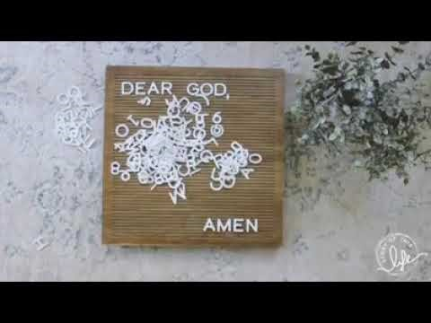

Slide 8
P – Pause; breathe deeply and be still in God’s presence.
R – Rejoice; what’s been good today? Thank God for it.
A – Ask God to help you and those you care about.
Y – say Yes to God; welcome His love, His plans and His presence into your day.

Slide 9
Rainbow Prayers…. Red: Praise Orange: Thankfulness Yellow: Ourselves Green: Others Purple: The Church

Slide 10
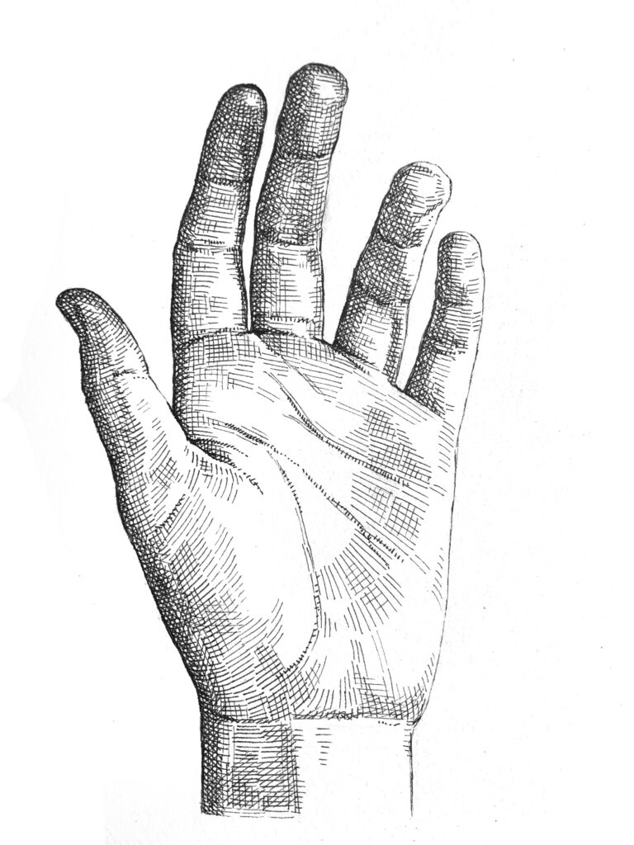
Handy Prayers
Teachers
Friends
Someone Ill
Neighbours
Family
Myself

Slide 11
Read – read the passage slowly and prayerfully several times over.
Reflect – think about what you have read. Are there particular words or phrases which stand out for you? What is God saying to you?
Respond – silently respond to what you feel God is saying to you in this passage, telling God all that you are thinking and feeling. Write it down in your prayer diaries.
Rest – put aside your thoughts and rest in the presence of God.

