Slide 1
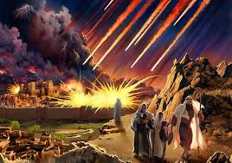
A message from the dark side of scripture... you have!
Sodom and Gomorrah
Things your Sunday School teacher didn’t teach you

Slide 2
A message from the dark side of scripture... you have!
Weird and wonderful cultural quirks
Things your Sunday School teacher didn’t teach you
In Tamil Nadu, devotees to the Hindu religion smash coconuts on their heads as a sign of asking for good health and success.
https://www.youtube.com/watch?v=g8mwqsXt7Rk
People in Malaysia use their thumbs to point

Slide 3
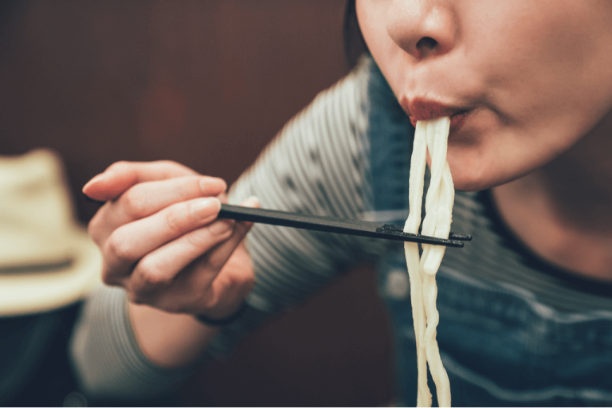
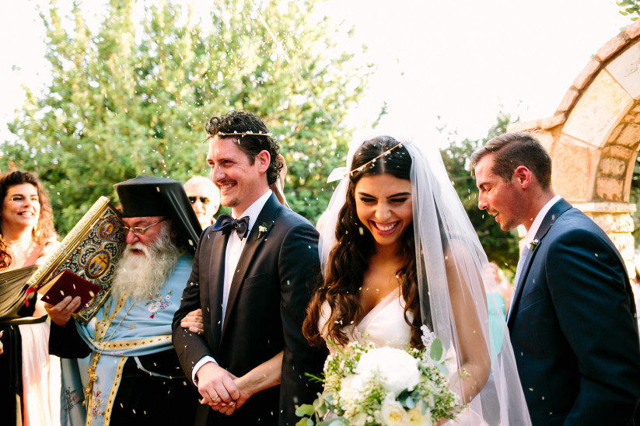
A message from the dark side of scripture... you have!
Sodom and Gomorrah
Things your Sunday School teacher didn’t teach you
In Japan people “slurp” their food, especially noodles!
It is a sign you are enjoying them.
Spitting on the bride at a Greek wedding is good luck! It is a ritual to ward of evil. (They actually just pretend to do it!)

Slide 4
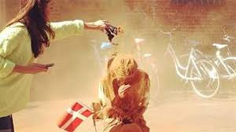
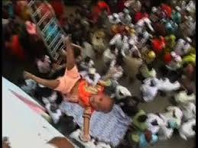
A message from the dark side of scripture... you have!
Sodom and Gomorrah
Things your Sunday School teacher didn’t teach you
In Denmark, when you turn 25, if you are not married, your friends and family throw cinnamon at you!
If you turn 30 and are single … pepper is thrown at you!
Baby tossing in India. In rural India babies and toddlers are thrown off the side of a temple 30-50ft and caught in a blanket. It is thought to bring good luck!

Slide 5
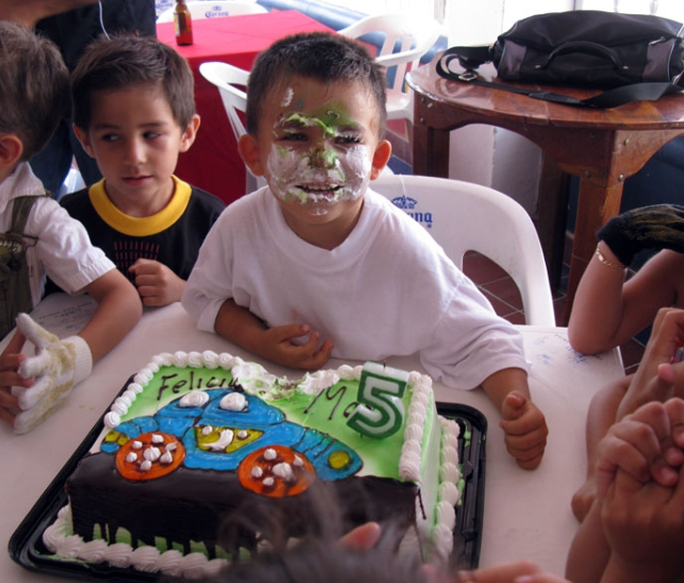
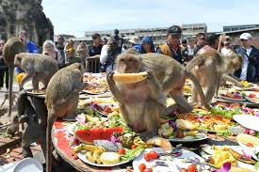
A message from the dark side of scripture... you have!
Sodom and Gomorrah
Things your Sunday School teacher didn’t teach you
In Mexico, on your birthday, the birthday girl or boy has their hands tied behind them and their faces pushed into a creamy cake, whilst everyone shouts “take a bite!”
The monkey buffet in Thailand. In Phra Prang Sam Yot temple in Lopburi, in late November, a sumptuous feast is set out, but not for humans, but for the thousands of monkeys that are thought to bring good luck to the area.

Slide 6
A message from the dark side of scripture... you have!
Sodom and Gomorrah
Activity 1
Things your Sunday School teacher didn’t teach you
Read Genesis 19:1-29.
What is shocking about this story?
Why do you think Sodom and Gomorrah had become such wicked places?
Why do you think God wanted to destroy the cities?
Was He right to?

Slide 7
A message from the dark side of scripture... you have!
Sodom and Gomorrah
Activity 2
Things your Sunday School teacher didn’t teach you
1. Abraham believed Lot to be a good man, that’s why he
wanted God to save the cities. Was Lot a good man?
2. How had Lot become like the people he lived amongst?

Slide 8
A message from the dark side of scripture... you have!
Sodom and Gomorrah
Activity 3
Things your Sunday School teacher didn’t teach you
What are the things in our world today that we see as normal that go against God’s best for us?
How has our world changed from the world our parents or
grandparents grew up in?
What do we look back at in History and say “why did Christians do that or allow that?”
What would Christians from the past see in our world and say,
“why do they think that is okay?”

Slide 9
A message from the dark side of scripture... you have!
Sodom and Gomorrah
Activity 4
Things your Sunday School teacher didn’t teach you
1. How can we escape “infection” by our culture?
2. How was Lot rescued? Who can rescue us now?
3. How do we live godly lives in a dark and godless world?
Matt 5:13-16, Ephesians 6:10-18, Phil 4:8-9

Slide 10
A message from the dark side of scripture... you have!
Sodom and Gomorrah
Takeaway
Things your Sunday School teacher didn’t teach you
Do everything without grumbling or arguing, so that you may become blameless and pure,
“children of God without fault in a warped and crooked generation.”
Then you will shine among them like stars in the sky as you hold firmly to the word of life.
Philippians 2:14-15

