Slide 1
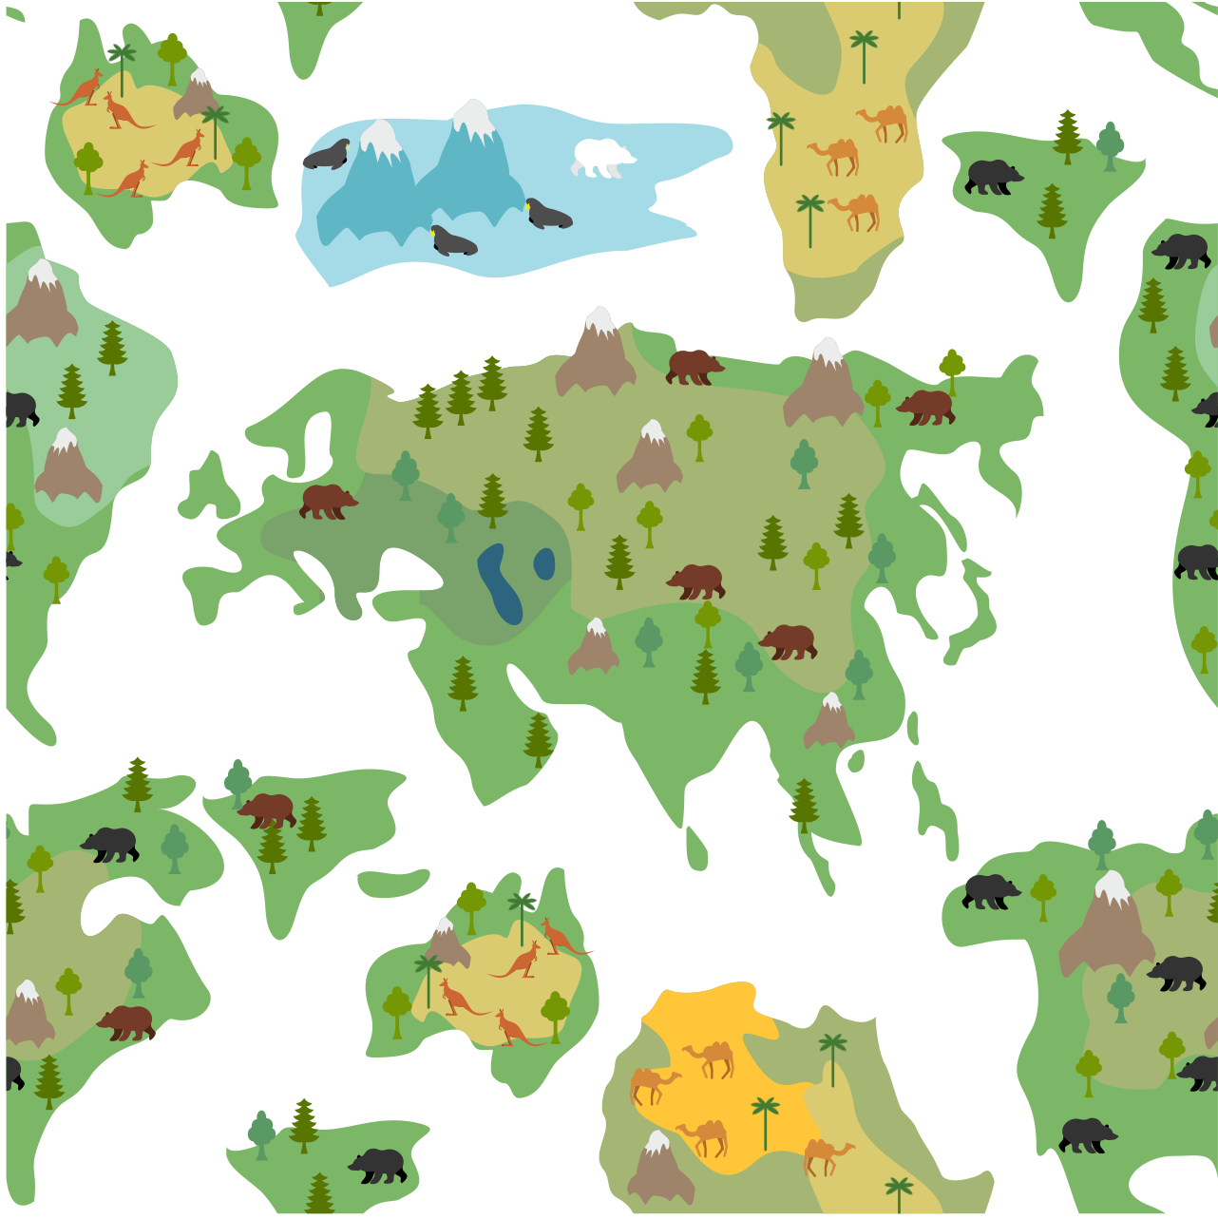
THANK
YOU!

Slide 2
THANK
YOU!
Arabic
shukran [shoe-kraan]
Bengali
dhonnobad [dhon-a-bad]
Cantonese
do jeh [daw-dyeh]
Czech
dêkuji [deh-ku-y ih]
Fijian
vinaka [Vee-Nah-Kah]
Gaelic
tapadh leat/leibh
[TAH-puh let/leave]

Slide 3
THANK
YOU!
German
danke [dahn-keh]
Greek
efharisto [ef-hah-rees-TOH]
Hebrew
toda [toh-dah]
Hindi
sukria [shoo-kree-a]
dhanyavād [Dhan-ya-bad]
Indonesian
terima kasih [t’ree-ma kas-seh]
Italian
grazie [g rats-yeh]

Slide 4
THANK
YOU!
Norwegian
takk [tahk]
Polish
dziekuje (dsyen-koo-yeh)
Portuguese
obrigado [oh-bree-gah-doh]
Japanese
arigatou [ahree-gah-tow]
Korean
kamsa hamnida
[kahm-sah ham-nee-da]
Mandarin
xièxie [shieh-shieh)

Slide 5
THANK
YOU!
Thai
kop khun (cap-coohn)
Ukrainian
ДЯКУЮ (DYAH-koo-yoo)
Welsh
diolch (DEE-ol’ch)
Romanian
mulţumesc (mool-tzoo-MESK)
Sri Lankan
istutiy [isst-too-tee]
Swahili
asante [ah-sawn-tay]

Slide 6
THANK
YOU!
What do you think the words
‘thankfulness’ and ‘gratitude’ mean?

Slide 7
When I look at my life I have so much to be thankful for
Strongly
agree
Strongly
Disagree
Agree
Neutral
Disagree

Slide 8
If I had to list everything I am thankful for, it would be a very long list
Strongly
agree
Strongly
Disagree
Agree
Neutral
Disagree

Slide 9
When I look at the world, I don’t think there is much to be grateful for
Strongly
agree
Strongly
Disagree
Agree
Neutral
Disagree

Slide 10
I probably take too many things for granted
Strongly
Disagree
Strongly
agree
Agree
Neutral
Disagree

Slide 11
I need to say thank you for things more often
Strongly
agree
Strongly
Disagree
Agree
Neutral
Disagree

Slide 12
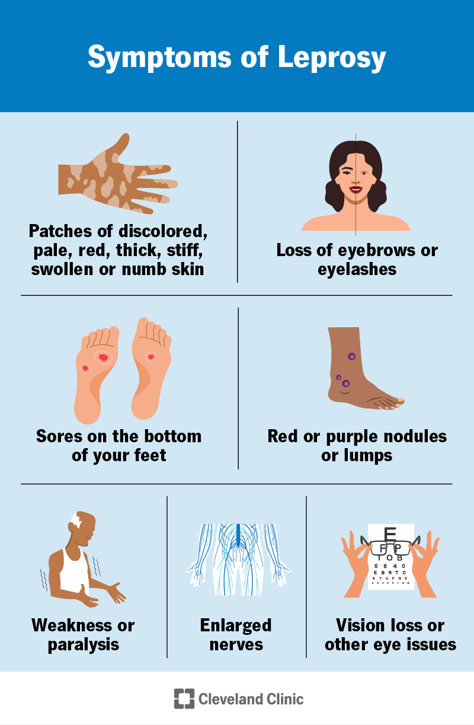
Key Aspects of Leprosy (Hansen's Disease):
Symptoms: Signs include discoloured, numb patches of skin, thick or stiff skin, painless ulcers, nerve damage, muscle weakness, and eye problems leading to blindness if untreated.
Transmission: It is transmitted via droplets from the nose and mouth during close, consistent contact with an untreated person. It is not spread by casual contact like shaking hands, sitting next to someone, or sharing meals.
Incubation Period: The bacteria grow very slowly; symptoms can take 5 to 20 years to develop after exposure.
Treatment: Leprosy is curable with multi-drug therapy (MDT), usually a combination of antibiotics taken over 6 to 12 months.
Complications: Untreated cases can lead to severe nerve damage, resulting in permanent disability, loss of sensation, and potential amputation of digits due to unperceived injuries.
Origin: The disease is one of the oldest known, mentioned in ancient medical texts

Slide 13
Jesus, Master, have mercy on us!
Go, show yourselves to the priests.
And as they went, they were cleansed.
One of them, when he saw he was healed, came back, praising God in a loud voice.
He threw himself at Jesus’ feet and thanked him – and he was a Samaritan.
Jesus asked, ‘ “ Were not all ten cleansed? Where are the other nine?
Was no one found to return and give praise to God except this foreigner?”’
Rise and go; your faith has made you well.

Slide 14
The original Greek word for well used here is sōzō (σῴζω).
sōzō doesn’t just mean physical healing. It can also mean:
to save
to rescue
to restore
to make whole
It’s the same word often used in the Bible for salvation, not just healing.

