Slide 1
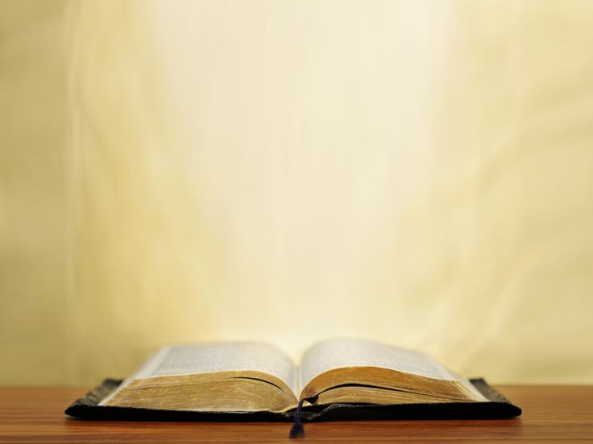
THE BIBLE

Slide 2
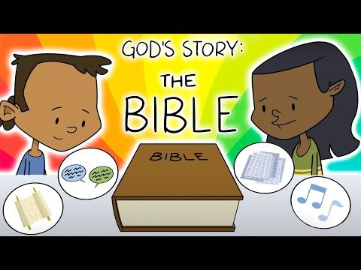

Slide 3

They had to thoroughly wash and prepare themselves.
They had to look at and say each word before writing it – not by memory.
If they made a single mistake on the page
then the whole page would need to be re-started.
They had people to check
their work afterwards for errors.
If three pages were found to have errors,
the whole manuscript was rewritten.
1. They were meticulous

Slide 4
2. They were cross checked with other manuscripts

Slide 5
Life’s big questions……?

Slide 6
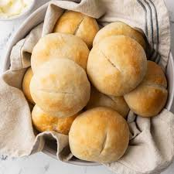
‘Man shall not live on bread alone, but on every word that comes from the mouth of God.’ Matthew 4:4

